Slide 1
Dialogue- Regulation 44 Visitor Forum December 18th 2020
Vaccinations- the next phase within the Covid 19 pandemic
Where are we currently?
Risks ahead.

Slide 2
Vaccination:
Oxford / Astra Zenica applying to the UK regulator for approval. Now in phase three trials.
Two injections approximately 21 days apart
100,000,000 doses on order
Traditional virus model used.
Pfizer / Biontech. Regulation agreed in UK and for emergency use in the US.
800,000 doses in the UK and now being used
Two injections approximately 21 days apart
Logistics chain requires v. low temperatures until final stage , then short term refrigeration
Moderna- now in phase three trials
New technology uses a micro – fragment of RNA of the coronavirus. Injected and starts viral replication in the body , whose immune system then triggers a response
Two injections four weeks apart
Notes:
Having both doses of the vaccine is key
BMA-British Medical Association
RNA, closely related to DNA, is present in all living cells. The strand of it called messenger RNA is a sequence of genetic code that tells cells what proteins to build so that they can function.
To produce an RNA vaccine, scientists develop a synthetic version of some of the virus’ messenger RNA.
When this is injected into the human body, our cells read it as an instruction to start building the proteins, including, in this case, Covid-19's distinctive 'spike' protein.
Our bodies then mount an immune response by producing antibodies to fight the virus proteins made by our cells. This prepares our immune system to fight the real virus if we encounter it later on.
This is different to the way some other vaccines work, where a small part of the virus itself, or the whole virus (weakened or dead), is injected into the body to trigger an immune response.

Slide 3
Vaccination:
You are unlikely to get a choice of vaccine.
In terms of herd immunity between 60-70% of the global population are thought to need to be vaccinated to stop the virus spreading easily. Billions of people
Antibody/ immunity length is not fully known yet. The Moderna vaccine at present seems to “hold up” for at least 4 months- follow up is ongoing.
Priority groups set out. Not likely to be all children at present- those shielding / specific cases only
Whole population injection under consideration

Slide 4
Priority groups
Priority/Risk group
1 Residents in a care home for older adults and staff working in care homes for older adults
2 All those 80 years of age and over and health and social care workers
3 All those 75 years of age and over
4 All those 70 years of age and over and clinically extremely vulnerable individuals (not including pregnant women and those under 18 years of age)
5 All those 65 years of age and over
6 Adults aged 18 to 65 years in an at-risk group (see below)
7 All those 60 years of age and over
8 All those 55 years of age and over
9 All those 50 years of age and over
10 Rest of the population (to be determined)

Slide 5
Clinical conditions considered
Clinical conditions list:
a blood cancer (such as leukaemia, lymphoma or myeloma)
diabetes
dementia
a heart problem
a chest complaint or breathing difficulties, including bronchitis, emphysema or severe asthma
a kidney disease
a liver disease
lowered immunity due to disease or treatment (such as HIV infection, steroid medication, chemotherapy or radiotherapy)

Slide 6
Clinical conditions considered
rheumatoid arthritis, lupus or psoriasis
liver disease
have had an organ transplant
had a stroke or a transient ischaemic attack (TIA)
a neurological or muscle wasting condition
a severe or profound learning disability
a problem with your spleen, example sickle cell disease, or you have had your spleen removed
are seriously overweight (BMI of 40 and above)
are severely mentally ill

Slide 7
Vaccination cont’d
New safeguarding dynamic for education and children’s services especially those services which support disabled children or those with difference, children with medical needs etc.
Issues such as managing the combination of a vaccinated and non vaccinated community, parental consent etc will need to be considered.
Vaccinations will have no impact on this wave or on a likely third wave. Likely to have an impact late summer 2021 onwards if everyone identified for vaccination has had both vaccinations and kept compliance going (face , space , hands) whilst the programme is rolled out. Unfortunately , this is not a seasonal virus.
Issue may arise as we have a “willing participant” approach- problematic?
20-30% drop off between first and second injection- problematic?
Immunity conferred 7-9 days after the second injection generally
Issue of vaccine hesitancy can also occur

Slide 8
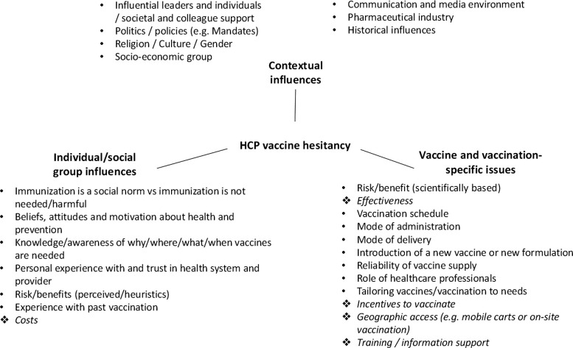
Vaccine hesitancy- can apply to anyone- think about staff , families , yourself …………………………..

Slide 9
Vaccination- issues:
Areas for Managers and RI / Headteachers and Heads of Care to consider in relation to vaccines:
You may have to manage a part vaccinated community / non-vaccinated community… how? What issues could arise ?
How will you know who has been vaccinated and who has not? Do you need to know?
How will you be sure that the person has received both vaccines?
Families / carers who refuse the vaccination?
Longer term view re. a possible ongoing booster programme
Potential roll out for whole population vaccination
Practicalities like time off work to have the injections?
Any other thoughts?
Notes:
Vulnerable children may be offered the vaccination quite quickly .
School nurse role?

Slide 10
R rate as of 11.12.20. Tier review for England 16.12.20
Region | R | Growth rate % per day
England | 0.8-1.0 | -2 to 0
East of England | 0.9-1.1 | -1 to +2
London | 0.9-1.1 | -1 to +1
Midlands | 0.8-1.0 | -3 to -1
North East and Yorkshire | 0.7-0.9 | -4 to -2
North West | 0.7-0.9 | -4 to -2
South East | 0.9-1.1 | -1 to +1
South West | 0.8-1.0 | -4 to 0

Slide 11
Risks ahead
Potential impact of Christmas from about second week in January onwards
Lack of public “buy in “ to face , space ,hands ongoing message
General weariness
Frustration at the lack of a quick fix
Logistics behind vaccination roll out and mass testing model
Others as in the slides above.

