Slide 1
Codesign in children’s residential care
John Woodhouse

Slide 2
Regulation 7 – children’s views, wishes & feelings standard
(1) children receive care from staff who –
develop positive relationships with them;
engage with them; and
take their views, wishes and feelings into account in relation to matters affecting the children’s care and welfare and their lives.
(2) The registered person must ensure staff (selected sections) –
Ascertain and consider wishes and feelings
Help each child express views, wishes and feelings
Help each child understand how views have been taken into account
Regularly consult about quality of the home’s care
Be able to raise issues with a relevant person about the service

Slide 3
Quality Standards
Children must be consulted regularly on their views about the home’s care, to inform and support continued improvement in the quality of care provided. Due consideration should be given to the child’s cognitive ability in the development and implementation of any consultation processes. Children should be able to see the results of their views being listened to and acted upon
Para 4.1

Slide 4
Inspection Outstanding children’s homes – young people’s perspective
Feeling positive
Strong relationships
Participation
Stability
Notes:
8. The young people’s perceptions of how the homes had made a difference to their lives provide a powerful testament to what makes these homes outstanding. Direct quotes from individual young people interviewed by inspectors punctuate this report and provide a vivid illustration of the analysis. The following points summarise some of the most striking or frequent views offered.
Feeling positive – young people said that the staff in these homes helped them feel positive about themselves and their lives again and supported them to want to do better in life and achieve their goals.
Strong relationships – young people felt close to the staff and particularly to their key workers. They did not want to let them down or disappoint them.
Participation – young people welcomed the opportunity to contribute to how the home was run through regular residents’ meetings and more informal day-to-day input.
Stability – young people felt safe and secure in these homes. They said they had been given another chance and knew they were not going to be moved. They felt confident that staff would not give up on them.
Outstanding Children’s homes (Ofsted, 2011)

Slide 5
Better, more effective support
Listening to young people and implementing what they say can produce significant improvements in provision. Their involvement in planning, developing, commissioning and providing services can suggest where and how to improve.
Notes:
C4EO - vulnerable children (PDF)

Slide 6
Young people know…
young people are really good at judging whether adults respect them or not
young people have lots of ideas and views about how they are cared for, and what would make life better for them.
young people are willing to share these ideas and views but professionals have to be genuine about wanting to listen and learn
we can make things much worse for children and young people when they do not support them to make and influence decisions about their own lives
many of the changes which children and young people want would not cost a lot of money
Notes:
https://bettercarenetwork.org/sites/default/files/Effective%20Participation%20of%20Children%20and%20Young%20People%20in%20Alternate%20Care%20Settings%20-%20Guidance%20for%20Policy%20Makers.pdf

Slide 7
It’s core task!
Adolescent-limited antisocial behaviour results from the “maturity gap” between adolescents’ dependence on and control by adults and their desire to demonstrate their freedom from adult constraint.
As they continue to develop and legitimate adult roles and privileges become available to them, there are fewer incentives to engage in antisocial behavior, leading to desistance in these antisocial behaviors.
Notes:
https://courses.lumenlearning.com/suny-hccc-ss-152-1/chapter/social-development/
A shift in expectations

Slide 8
It’s core task!
Multi-facted, positive interventions
Avoids placing child as central ‘object of concern’
Small groups to review following article
How many aspects of Quality Standards can you find in this piece of work
https://blog.barnar.do/creating-safe-spaces-online-7ff2ca35ce4
Notes:
Barnardos have a good example of looking at online services with young people – it’s core task around education, safeguarding, communication about trauma, independence, citizenship
The quality and purpose of care standard 13
The children’s views, wishes and feelings standard 20
The education standard 25
The enjoyment and achievement standard 30
The health and well-being standard 32
The positive relationships standard 37
The protection of children standard 41
The leadership and management standard 51
The care planning standard 55
So what areas might your home actively involved children and young people in?

Slide 9
co-design; a process which not only ensures we have the clearest possible picture of children and young people’s needs and experiences, but allows us to design life-changing services in a truly collaborative fashion.
Barnardos
Notes:
https://blog.barnar.do/co-designing-with-children-and-young-people-9853bd243dbe

Slide 10
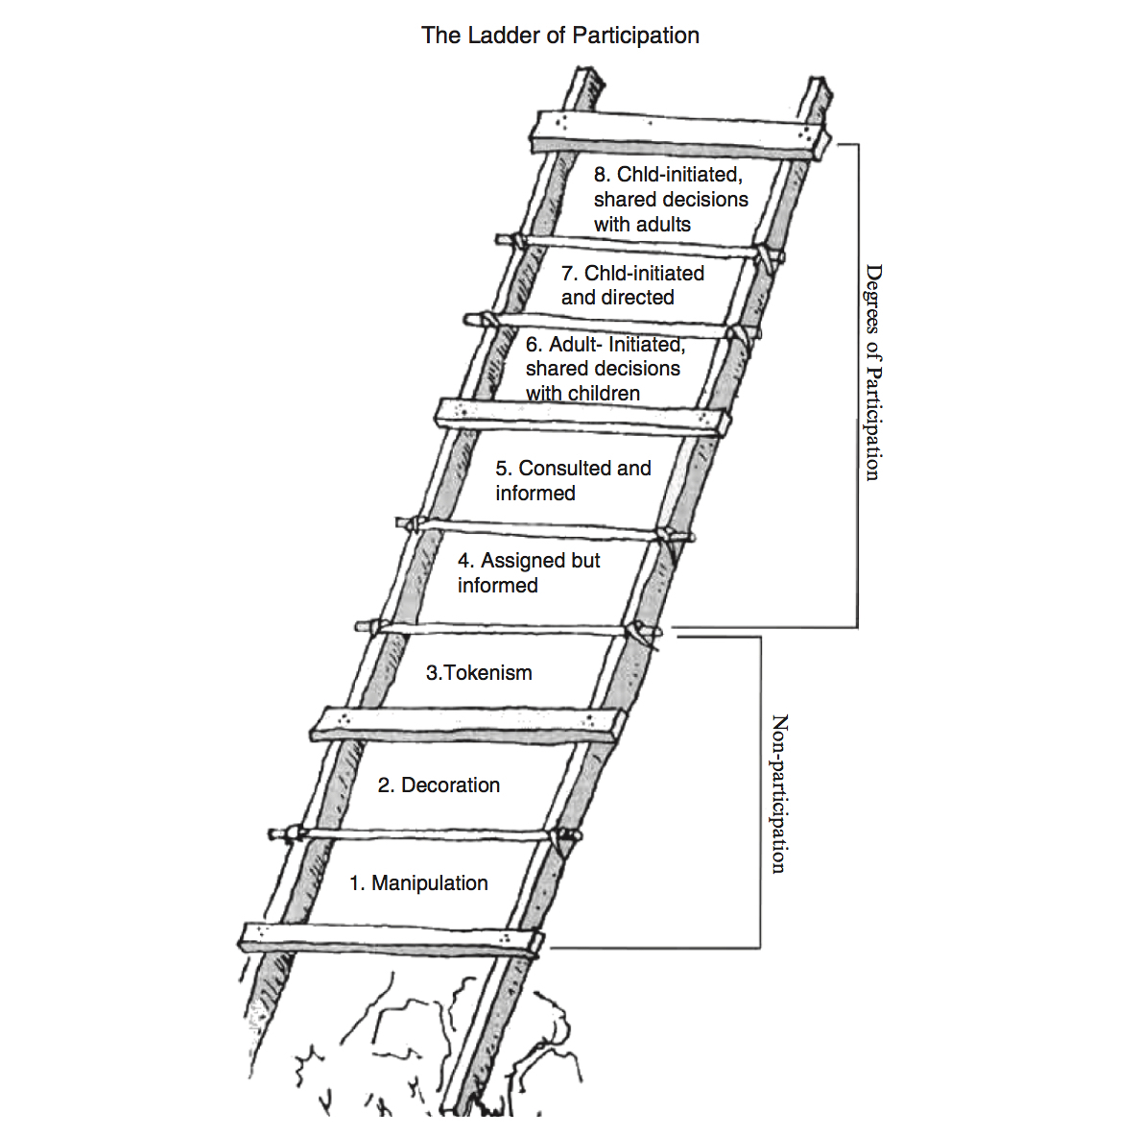
Ladder of participation (Hart, 1992)

Slide 11
Examples of participation… where on the ladder?
Young person’s guide
A survey
Weekly young person’s meeting
Young people invited to team meeting, board meeting
Advocacy service in the home
Recruiting staff
Decorating their bedroom
What else….?

Slide 12
Critiques of the ladder…
Child development is not sequential
Project focus rather than a value model
It’s not about loss of adult control
Cultural bias around independence being a good thing…
Notes:
Including by Hart!
https://organizingengagement.org/models/ladder-of-childrens-participation/

Slide 13
Tips for participation
What, when, why…?
How?
Make it relevant, exciting and contemporary
Talk to young people (obv!)
Be clear about how information will be used
Make things clear – consider communication options
Open questions – avoid manipulation!
What’s in it for young people?
Is participation ‘a way of being’
how do you evidence this
Notes:
What when why – be clear what you’re trying to do with yourself first of all. How much authority will young people have? Where on the ladder of participation are you aiming?
What approach will you take? Formal? Informal? Who would be involved? Are they clear about the goals?
Relevant/Contemporary – development of language games and use of popular culture e.g. Dragon’s Den exercise. Example of Big Brother shopping list exercise. https://www.researchgate.net/publication/260995180_Engaging_teenagers_productively_in_service_design
Make sure you frame your questions with an explanation. Tell them why you are asking or why you are interested, so they do not feel like they are in trouble and to show that you respect and value their views.
Give them the option to remain anonymous, if they wish. Explain how the information will be used. If you are meeting children and young people face to face (through a Youth Forum or in a team meeting, for example) make sure the young people understand the process - i.e. that information will be used to inform service design, sometimes it may not be possible for all of their preferences to be met, all of their ideas and thoughts will be listened to and will be very helpful in shaping the services
Make things clear – de-professionalise and think SEND – for yp where we really struggle to understand talk to those who know them best about the kind of things they pick up the young people communicate about the services they receive Avoid jargon and acronyms. Simplify your words and sentence structures as much as possible. Explain difficult or complex terms, where necessary. Consider how you can support the participation of CYP with more complex communication, language and learning needs, for example, Makaton, British Sign Language or easy read materials. Perhaps you can utilise the contacts and facilities you have to access the views of these children. The first step is to ask the CYP or parent/carer how you can best communicate with them. Is there an impartial person involved with the CYP that can support them to access the forms or surveys in the way they want to communicate? If the CYP is already in the service, can a member of staff support them one-to-one to interpret questions and simplify ideas?
Open questions - Try an open question at the end. For example, ‘Is there anything else we could do better?’ or ‘Do you have any other ideas to share with us?’ There is often something extra that was not on our agenda, or we did not envisage being relevant or important. This will give children and young people space to tell us what is important to them, without always being led by our questions.
What’s in it for young people - Consider what’s in it for the young people. Could you offer a high street voucher to the child or young person who has the most original response on Facebook? Could offer to write a work or college reference for a young person who attends your team meeting?
https://councilfordisabledchildren.org.uk/media/30248/Participation-Tips-for-Service-Design.doc

Slide 14
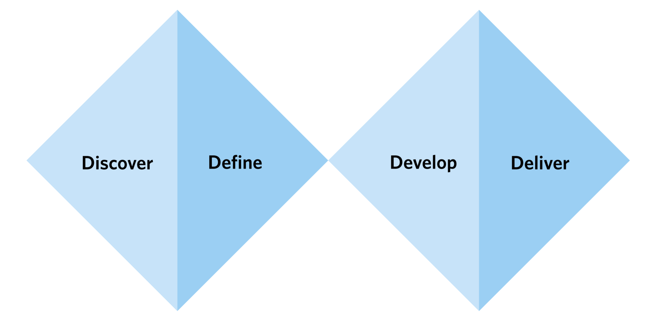
Notes:
Phased approach – brilliant codesign guide here…
https://www.orygen.org.au/Training/Resources/Service-knowledge-and-development/Guidelines/Co-designing-with-young-people-The-fundamentals/Orygen-Co-designing-with-YP-the-fundamentals?ext=.

Slide 15
Where next…
Working together to improve children and young people’s participation?
Notes:
Participation leads in residential care group?

