Slide 1

Registered Manager Forum July 20th 2021
Current challenge re. sexually harmful behaviour

Slide 2
Focus areas in the session
Review of current thinking related to sexually harmful behaviour
Reviewing the protective features of a positive safeguarding culture
Planning for change
Planning for staff updating

Slide 3
Ofsted review in schools following the Everyone’s Invited website disclosures
Transferable principles from the report re. sexually harmful behaviour . This was identified as a societal issue . School has a key part to play in supporting young people as does children’s social care.
The report “……has revealed how prevalent sexual harassment and online sexual abuse are for children and young people. It is concerning that for some children, incidents are so commonplace that they see no point in reporting them”
“On our visits, girls told us that sexual harassment and online sexual abuse, such as being sent unsolicited explicit sexual material and being pressured to send nude pictures (‘nudes’), are much more prevalent than adults realise.”
Notes:
Within this should sit :
leadership
shared vision and values
respect for children and young people
positive modelling of behaviour by the adults
being accessible to young people
being trusted by young people
personal awareness of one’s own bias , values , unconscious bias- reflection and correction if they do not align with the whole school culture. Need for training?
Harvard model and associated documentation

Slide 4
Ofsted review in schools following the Everyone’s Invited website disclosures
“The frequency of these harmful sexual behaviours means that some children and young people consider them normal.”
“When we asked children and young people where sexual violence occurred, they typically talked about unsupervised spaces outside of school, such as parties or parks without adults present……………………”

Slide 5
What are the range of sexual behaviours?
Normal | Inappropriate | Problematic | Abusive | Violent
-Developmentally expected - Socially acceptable - Consensual, mutual, reciprocal - Shared decision-making | - Single instances of inappropriate sexual behaviour - Socially acceptable behaviour within peer group - Context for behaviour may be inappropriate - Generally consensual and reciprocal | - Problematic and concerning behaviour - Developmentally unusual and socially unexpected - No overt elements of victimisation - Consent issues may be unclear - May lack reciprocity or equal power - May include levels of compulsivity | - Victimising intent or outcome - Includes misuse of power - Coercion and force to ensure victim compliance - Intrusive - Informed consent lacking or not able to be freely given by victim - May include elements of expressive violence | - Physically violent sexual abuse - Highly intrusive - Instrumental violence that is psychologically and/or sexually arousing to the perpetrator - Sadism
Figure 1. Definition: Sexual behaviours across a continuum
Notes:
Do you recognise any of these in the home ? Do you concerns re. anyone people in the home?

Slide 6

Culture is……………
about leadership
about connections
about communication
fundamental
a positive model
a positive model of behaviour which is shared , known and understood
shared vision
common beliefs , values and actions
CULTURE IS WEAKER WHEN CONNECTIONS ARE POOR OR INFREQUENT
Notes:
Is this a reflection of your culture / safeguarding culture?

Slide 7
A good culture arises from messages that promote traits like collaboration, honesty, and hard work.
Fundamental beliefs and assumptions, or the things that the team at your home consider to be true.
Shared values, or the judgments people at your home make about those belief and assumptions — whether they are right or wrong, good or bad, just or unjust.
Norms, or how members believe they should act and behave, or what they think is expected of them
Notes:
Harvard model and associated documentation

Slide 8
A good culture arises from messages that promote traits like collaboration, honesty, and hard work.
4. Patterns and behaviours, or the way people actually act and behave in your home.
5. Tangible evidence, or the physical, visual, auditory, or other sensory signs that demonstrate the behaviours of the people in your home.
Each of these components influences and drives the others, forming a circle of reinforcing beliefs and actions
Notes:
5 key stages
If patterns and behaviours expressed by adults are concerning or do not align with expectations- what happens?
Do you see a positive culture?
Harvard model - range of surveys to test bias , assumptions and likely responses

Slide 9
Positive safeguarding culture led by the Manager:-
Sits within a whole service culture / model e.g. McKinsey
A positive culture encompasses a range of protective features.
You demonstrate :
- an ability to build effective working relationships with staff and others.
an ability to advise and support individuals at all levels within an organisation.
an ability to act with integrity and respect when working with others.
robust management skills.
effective communication skills.
influencing skills.

Slide 10
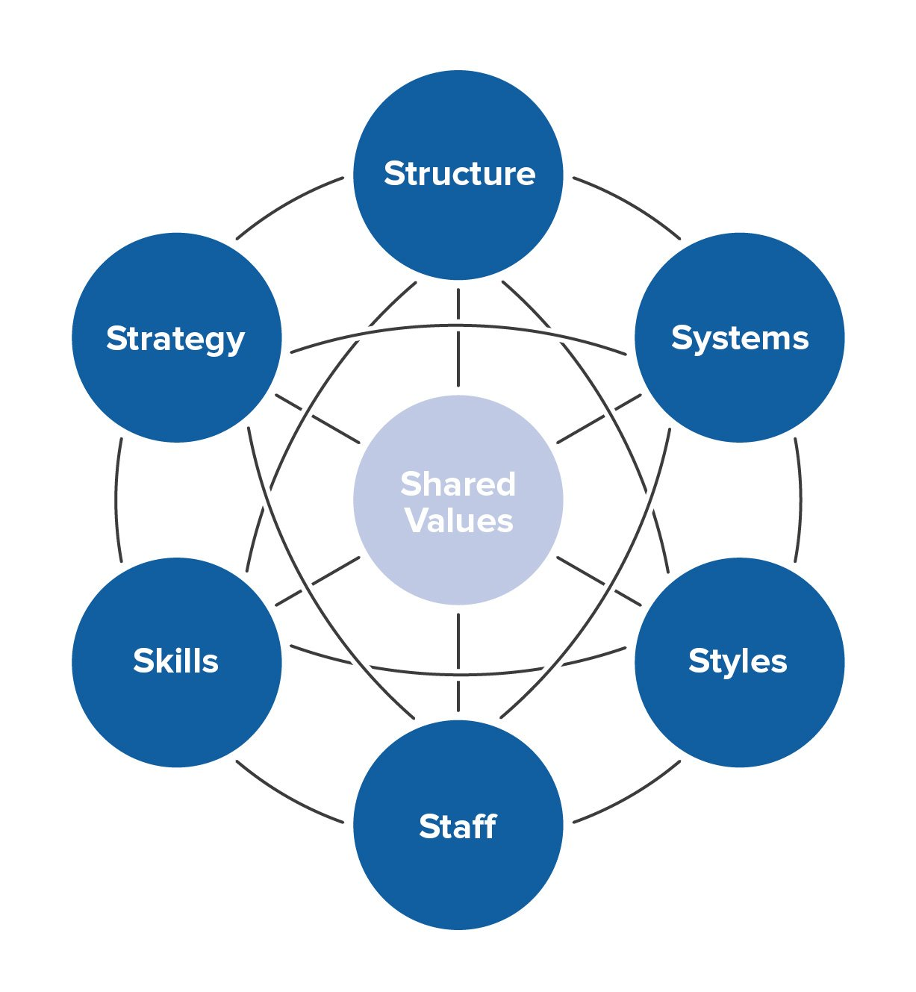
Culture structure- McKinsey 2016
Notes:
Courtesy of McKinsey 7 S diagram 2016. Top 3 are easy to measure in a culture , the four “softer “ elements less so but can capture the elements related to the personal values , behaviours , responses of adults within both a safeguarding culture and wider world culture
The model can also be sued very successfully in creating a positive safegaurding culture

Slide 11
Positive safeguarding culture – some constituents and protective features within the current context:
Leadership
Safer recruitment
Training / knowledge base
Accountability
Environment
Covid/ coronavirus response
Appraisal , supervision
Effective monitoring RM and RI- strategic oversight and challenge
Safeguarding as a foundation of practice
Code of conduct
Policies/processes/procedures
Record keeping
Focus on all aspects of vulnerability
SEND
Healthy challenge
Whistleblowing
Notes:
The role will also encompass:
Observations of staff behaviour
Robust training which is consistently throughout the academic year
Can be used as key tests in the current climate

Slide 12

Culture:
Data- reporting , recording , responses.
Accidents / incidents
Interventions
Complaints
Health and safety
ANYTHING ELSE?
The VOICE of the child……
Notes:
Never underestimate the voice of the child –

Slide 13
The challenges:-
This may feel “ personal “ for staff as it can challenge their own life views
Do staff struggle to accept the key issues
Are there known issues in the home related to staff approach , behaviour management , staff responses( especially, to safeguarding concerns)
Do you need to review your safeguarding features in the light of this report?
Need for further training – using the positive model approach?
Any more you can think of?
Notes:
https://www.gov.uk/government/publications/review-of-sexual-abuse-in-schools-and-colleges/review-of-sexual-abuse-in-schools-and-colleges
What should be done to support / train staff / others in the home who find the culture adjustment difficult?

Slide 14
Any thoughts? Any comments? Areas to follow up re. staff knowledge?

