Slide 1
The Regulation 44 Forum
December 6th 2021
Chris Freestone

Slide 2
Update : - sector - pandemic

Slide 3
Pandemic update
3.12.21 rounded data
R rate England – 0.9-1.1
R rate variations in England 0.9-1.2
80.8% both vaccines – 12+ years
33.8% eligible had their booster or third dose
48-50K positive daily cases
830+ deaths daily
Approx.800 admissions per day

Slide 4
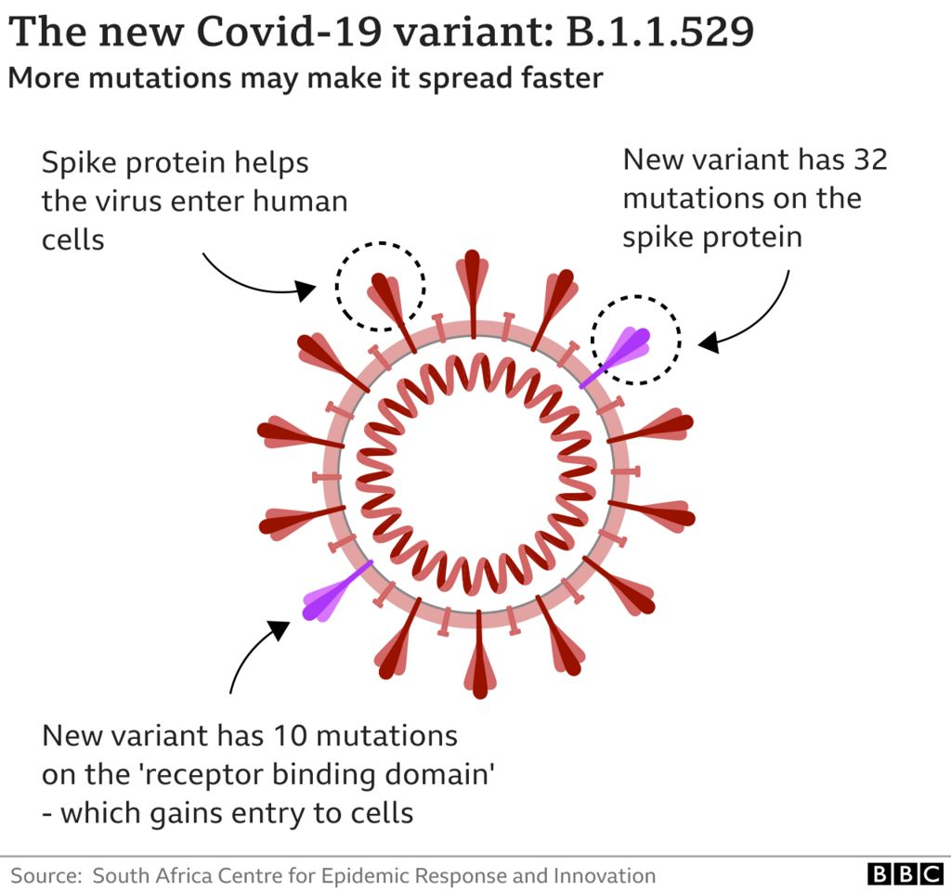

Slide 5
Omicron variant
New virus variant detected and identified by the WHO as a variant of concern.
Omicron variant heavily mutated and substantial variance from the Delta variant. Likely more transmissible. Possibly vaccine avoidant- to what extent? Waiting for the science ………….
Schools year 7 + guidance re. wearing masks in social areas of schools. ? LFT before returning to school after Christmas.
Facemasks on public transport and in shops.
Boosters / vaccinations:
18-39 to be offered booster 3 months after second vaccine
12-15 years second vaccine no sooner than 12 weeks after first
16-17 + dose 2 twelve weeks after the first
Plan to offer all adults booster by end of January 2022
114 million extra booster doses already ordered- enough for the next two years . Other orders ongoing.

Slide 6
For us to think about--- have services……..?
Reviewed the local situation
Reviewed their visitors policies
Discussed with children and young people ?
Reviewed risk assessments ?
Got effective communication with schools and colleges re. changes there and post Christmas planning?

Slide 7
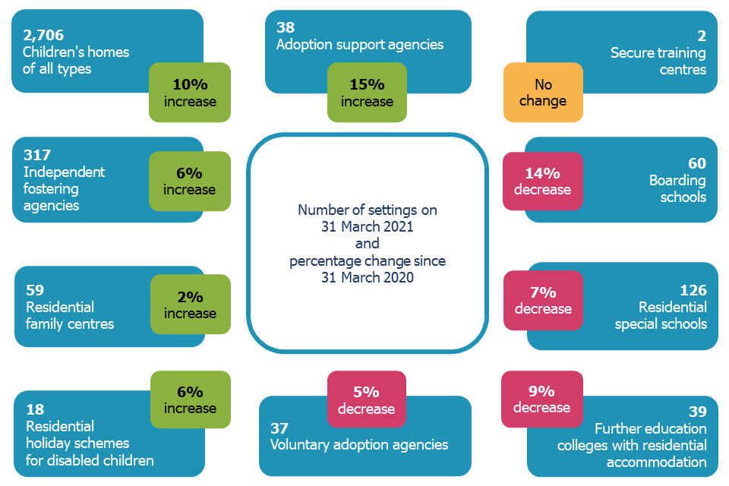
Other updates

Slide 8
Updates and headlines:
“The LGA said the number of looked-after children has risen from 64,470 children in care in 2009-10, or 57 in every 100,000, to 80,080 or 67 in every 100,000 in 2019-20.”
Possible increase to over 100,000 looked after children by 2025.
LGA noted the funding needed – £2.7bn by 2024-2025
Independent Care Review calls for views on “solutions.” reply by December 15th 2021.
Notes:
Community Care 10.21

Slide 9
Ofsted / CIW ------ from inspections
1. Supervision- robust , reflective basis for learning , outcomes tracked
2. Statement of Purpose aligning with observed and recorded practice
3. Record keeping
4. Voice of the child
5. Effective use of Regulation 45 reports
6. Keeping safeguarding policies up to date
7. Completion of regulatory qualifications within timescales.
Any other current thoughts……………..

