Slide 1
Living with Covid
RI Continuing Professional Development
15th February 2022

Slide 2
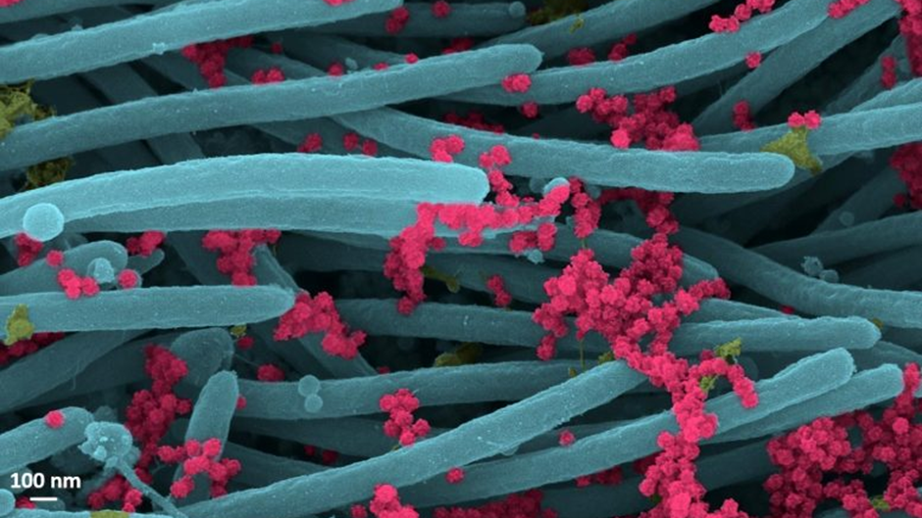

Slide 3
The photo:
These are what are known as SARS-Cov-2 virions under electron microscopy on the cilia of cells in the human respiratory tract. The yellow is mucus, the red SARS Cov 2 , these are then sneezed , coughed out etc and spread – further in the individual or as droplets into the air for transfer etc.
Virions are the complete, infectious form of the virus released onto respiratory surfaces by infected host cells.
This imaging research helps illustrate the incredibly high number of virions produced and released per cell inside the human respiratory system. The large viral burden is a source for spread of infection to multiple organs of an infected individual and likely mediates the high frequency of COVID-19 transmission to others. These images make a strong case for the use of masks by infected and uninfected individuals to limit SARS-CoV-2 transmission.
Reference: “SARS-CoV-2 Infection of Airway Cells” by Camille Ehre, Ph.D., 3 September 2020, New England Journal of Medicine. DOI: 10.1056/NEJMicm2023328
NB 100nm is the thickness of a sheet of plain A4 paper..
Chris Freestone. Dialogue . 9.2020

Slide 5
update
11.2.22 rounded data
R rate England – 0.8-1.1
R rate range 0.8-1.1
84.7% both vaccines – 12+ years
65.6% eligible had their booster or third dose
45-49K positive cases 11.2.22
167 deaths UK 11.2.22
Approx.1400 admissions per day
Notes:
Total bed nos. England 144,000

Slide 6
For us to think about…… with changes in restrictions have you?
Made sure you are aware of the changes
Assessed whether as a home you are retaining key elements of managing risk e.g. visitors to the home
Reviewed the local situation and made a local judgement ?
Checked what is happening in the secondary schools young people attend – some are retaining masks in classrooms and half term is coming up.
Discussed with children and young people-new protocols/ rules?
We still have Omicron and Delta variants in circulation…..

Slide 7
Changes to come
Possible removal of the need to self isolate etc from end of February 2022- how are you going to manage this ?
Ongoing use of lateral flow tests?
Revised risk assessments ?
Revised emergency plans and location review?

Slide 8
Ongoing…….
The outcome of the pandemic for children and young people is said to be likely to “impact a generation.”
Issues to consider when young people come to you….
Impact of safeguarding issues such as domestic abuse , neglect , poverty etc for children and families during this period
over exposure to social media
increased levels of self harm and suicidal ideation
CCE, CSE

Slide 9
Ongoing….
Schools are picking these up as well as the following patterns and trends:-
Social and emotional regression
Blurring of boundaries between home and school with home teaching and learning
Disengagement with learning
Uncertainty and anxiety in sitting public examinations.
Deterioration in behaviours and responses especially for children and young people who have ADHD, ODD, ASD etc

Slide 10
Taking these factors into account…how will the following be impacted?
Placing
Matching
Impact risk assessments
Statement of Purpose
Access to education and alternative provisions
Access to therapies etc
Specialist staff / training ?
On costs?

Slide 11
Still to be decided and / or will have an influence :
Long term booster roll out?
Ongoing vaccination programme?
Rescinding of the mandatory vaccination for those working with older people?
Passing through Parliament of the rescinding of mandatory vaccination in health care?
Understanding of the impact of vaccination fatigue in the population.
New variants …….
Inflation rate ? Cost of living rises? Minimum / living wage costs?
Notes:
Impact on staffing throughout….

Slide 12
Key report and research identifying broad range of issues which will impact at personal , service , societal levels:-
https://www.thebritishacademy.ac.uk/publications/covid-decade-understanding-the-long-term-societal-impacts-of-covid-19/

Slide 13
Nine areas of long term concern identified in the report...
1. Increased importance of local communities
2. Low and unstable levels of trust- government , media, politicians etc.
3. Widening geographic inequalities
4. Exacerbated structural inequalities
5. Worsened health outcomes and growing health inequalities
6. Greater awareness of the importance of mental health
7. Pressure on revenue streams across the economy
8. Rising unemployment and changing labour markets
9. Renewed awareness of education and skills

Slide 14
What next?
Open discussion……

Slide 15
App. 1 Clinical conditions considered
Clinical conditions list:
a blood cancer (such as leukaemia, lymphoma or myeloma)
diabetes
dementia
a heart problem
a chest complaint or breathing difficulties, including bronchitis, emphysema or severe asthma
a kidney disease
a liver disease
lowered immunity due to disease or treatment (such as HIV infection, steroid medication, chemotherapy or radiotherapy)

Slide 16
Clinical conditions considered
rheumatoid arthritis, lupus or psoriasis
liver disease
have had an organ transplant
had a stroke or a transient ischaemic attack (TIA)
a neurological or muscle wasting condition
a severe or profound learning disability
a problem with your spleen, example sickle cell disease, or you have had your spleen removed
are seriously overweight (BMI of 40 and above)
are severely mentally ill

Slide 17
App.2 Vaccine hesitancy….
CONTEXTUAL INFLUENCES
family
socio-economic group
peer group
influential leaders and individuals
politics/policies
religion
culture
gender
social media.
INDIVIDUAL AND SOCIAL GROUP INFLUENCES
Immunisation is a social norm VS immunisation is not needed/harmful
Beliefs , attitudes and motivation about health prevention
Knowledge and awareness of why/where/what/when vaccines are needed
Personal experience with and trust in health system and provider
Risks/benefits- as perceived
Experience with past vaccination

Slide 18
Vaccine hesitancy
VACCINE AND VACCINATION SPECIFIC ISSUES
Risk / benefit
Access to vaccination
Mode of administration/ delivery
Introduction of a new vaccine
Reliability of vaccine supply
Role of healthcare professionals
Any incentive to be vaccinated
Information and follow up
Any others you can think of?

