Slide 1
RM FORUM
26.4.22
Chris Freestone / Dialogue

Slide 2
Points to consider:
Pandemic update
Long Covid
CMA final report summary findings
Updates and findings.

Slide 3
Pandemic update
22.4.22 rounded data
R rate England – 0.9-1.1
R rate variations in England 0.8-1.1
86.4% both vaccines – 12+ years
68% eligible had their booster or third dose
185,625 positive cases – 7 day rolling total
Approx.13,752 admissions – 7 day rolling total
1956 deaths – 7 day rolling total

Slide 4
Pandemic updates:
Booster offer for over 75 years old and those who are immune suppressed continues
Free LFT’s discontinued
Care home residents, hospital patients and other vulnerable groups will still be given free tests if they have symptoms. Concerns from those who are vulnerable and elder care sector that the restrictions have increased the level of risk for those groups.
Costs-£1.75-£2.25 per individual test .
Omicron variant XE detected- 2000 cases so far. Being tested – combination of x2 Omicron variants . Possibly 10% more infectious
Vaccine still the main way to combat spread and serious disease

Slide 5
Covid 19 -------- Long Covid
This is a new follow on disorder /syndrome…
1.5 million people at present have presented with Long Covid
Length of time of impact is uncertain at the moment

Slide 6
What is Long Covid ?
For some people, coronavirus (COVID-19) can cause symptoms that last weeks or months after the infection has gone. This is sometimes called post-COVID-19 syndrome or long COVID
How long it takes to recover from COVID-19 is different for everybody.
Many people feel better in a few days or weeks and most will make a full recovery within 12 weeks. But for some people, symptoms can last longer.
The chances of having long-term symptoms does not seem to be linked to how ill you are when you first get COVID-19.
People who had mild symptoms at first can still have long-term problems.

Slide 7
Symptoms of Long Covid
Common long COVID symptoms include:
extreme tiredness (fatigue)
shortness of breath
chest pain or tightness
problems with memory and concentration ("brain fog")
difficulty sleeping (insomnia)
heart palpitations
dizziness

Slide 8
Symptoms of Long Covid:-
pins and needles
joint pain
depression and anxiety
tinnitus, earaches
feeling sick, diarrhoea, stomach aches, loss of appetite
a high temperature, cough, headaches, sore throat, changes to sense of smell or taste
rashes

Slide 9
Long Covid:-
It is estimated that anywhere from 10% to 30% of patients might experience long COVID after recovering—even if they weren’t very sick in the first place.
Long COVID can be broken down into three categories:
1. COVID-19 itself “ has direct cell damage because of the virus and this can cause lingering symptoms.”
This means that people with COVID-19 ,do not recover completely and have ongoing symptoms because of direct cell damage from the virus
Notes:
Dr Sanghavi . AMA. Feb 2022

Slide 10
Long Covid:-
2. The second category of Long COVID is when a person’s symptoms are related to chronic/long term hospitalisation, this includes ITU / HDU prolonged admissions
This can also cause:
inherent muscle weakness.
inherent cognitive brain dysfunction.
inherent psychosocial stress causing post-traumatic stress disorder-like syndrome, which is also called post-ICU care syndrome
3. Cases in which symptoms appear after recovery- may be linked to long term inflammatory responses in the body.
NB:-It could be that the initial infection sends some people's immune systems into overdrive, meaning they attack not just the virus but their own organs.
The virus entering and damaging cells might explain some symptoms like a loss of smell and taste, while damage to blood vessels could, for example, contribute to heart problems.
Notes:
Dr Sanghavi . AMA Feb 2022
NHS England

Slide 11
Children and Long Covid
Children may complain of fatigue and a difficulty in concentration-this impacting school / education
Insomnia
Long COVID in adults and children has symptoms which may be similar, but the number/% of patients affected is lower in children

Slide 12
Long Covid is likely to have an impact for employers for the foreseeable future
Sickness and absence because of long COVID
For some people, coronavirus (COVID-19) can cause symptoms that last weeks or months after the infection. This can be called 'post-COVID-19 syndrome' or 'long COVID'.
Long COVID symptoms could affect someone's ability to work or cause them to take sickness absence.
The usual rules for sickness absence and sick pay apply when someone is off work because of long COVID(ACAS)

Slide 13
ACAS advice cont’d
What the employer should do
Employers should be aware that the effects of long COVID can come and go. On some days the person might seem well, but on others their symptoms can be worse and they might need to be off work again.
If someone is off sick, they might feel isolated or need support to return to work. Employers should:
agree how and when to make contact during any absence
make sure their work is covered and shared out appropriately while they’re off
talk about ways to support them as they return to work where and when possible

Slide 14
ACAS advice cont’d:
When the employee feels able to return to work
The employer should talk with the employee about any support they may need. They could discuss:
getting an occupational health assessment
making changes to the workplace or to how the employee works, such as different working hours
a phased return to work
what they want to tell others at work about their illness

Slide 15
Is long Covid a disability ?
Under the law, a disability is a physical or mental impairment that has a 'substantial and long-term' negative effect on a person's ability to do normal day-to-day activities.
'Long term' means the impairment:
has lasted or will last for at least 12 months
can come and go or is likely to last for the rest of the person's life
Long COVID is still a new illness, and it may take time to understand it fully. It can affect a person's day-to-day activities and it's currently understood that it can last or come and go for several months. The effects of long COVID could also cause other impairments.
It's a good idea for the employer to focus on the reasonable adjustments they can make rather than trying to work out if an employee's condition is a disability.

Slide 16
Updates and headlines:
1.
https://www.gov.uk/government/publications/why-do-children-go-into-childrens-homes

Slide 17
Summary- main findings:
Main findings
Our main findings from the questionnaire responses of those who took part in the study show that:
the current placement was the first time ever in care for almost one fifth of the children
residential care was part of the intended care plan for just over half of the children
foster care was part of the original care plan for just over one third of the children
two thirds of the children entered a children’s home because of some form of interruption in their previous care: foster placement breakdown (41%), children’s home breakdown (15%) or family breakdown (12%)
the move to a children’s home was planned for almost four fifths of the children; that is, all the necessary preparations were made in advance
the move to a children’s home was an emergency move for one fifth of the children; that is, events either at home or in another care placement meant that urgent action had to be taken that resulted in the child entering the children’s home
around three quarters of the children were judged – by the inspector and registered manager – to be well matched to the home

Slide 18
Updates and headlines:
2.
https://www.gov.uk/government/news/strong-signs-of-recovery-across-education-but-challenges-remain
Emotional and social development- all ages , especially early years
Language development
Anxiety
Mental health
Managing over- exposure to social media.
Increased levels of vulnerability for looked after children.

Slide 19
Updates and headlines:
2.
https://www.gov.uk/government/publications/childrens-social-care-market-study-final-report

Slide 20
Updates and headlines:
CMA report
Key findings :
Need for review of regulations
Need for review of planning regulations
CQC style annual “ state of the nation “ review
Large scale market engagement strategy
Money to LAs for forecasting etc
Support for LAs in terms of fostering developments , forecasting
LAs to have structures in place(possibly under regulation) to monitor the risk of provision failure in the independent residential care market
Independent providers to have clear contingency plans in place for failure of any or all of its component parts

Slide 21
Sector dated updated 30.3.22
https://www.gov.uk/government/statistics/childrens-social-care-data-in-england-2021/main-findings-childrens-social-care-in-england-2021
The number of new children’s homes in England continues to rise.
As at, 31 March 2021, there was an 11% increase in the number of homes and an 8% increase in the number of places compared with 31 March 2020. Although there was a smaller gap between them this year, it continues the long-standing trend of the number of new homes rising faster than the number of new places.
All regions saw an increase in the number of children’s homes as at, 31 March 2021.
Although all regions saw an increase in numbers, children’s homes are still not evenly distributed across England. The North West still accounts for just over a quarter of all children’s homes, and almost a quarter of all places.
Notes:
Ofsted 31.3.22

Slide 22
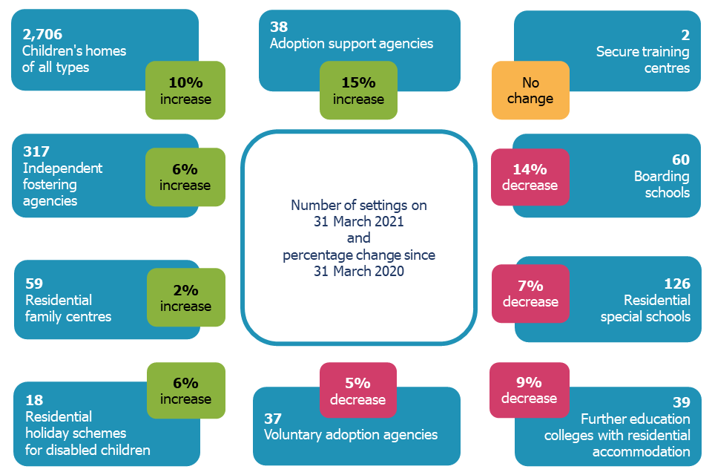

Slide 23
Sector updates March 2022
On 31 March 2021, there were 3,402 social care providers. This is an 8% increase compared with 31 March 2020, when there were 3,158 providers. Most of this increase can be accounted for by the increase in children’s homes.
Out of the 12 million children living in England, just under 400,000 (3%) are in the social care system at any one time. More than 80,000 of these children are children in care. As at, 31 March 2021, across England, there were 151 LAs responsible for ensuring and overseeing the effective delivery of social care services for children.
Reflection : Data projections from LA’s suggest an increase to up to c. 100K Looked After Children by 2025

Slide 24
Lots’ to think about :
Any thoughts or reflections ?

