Slide 1
Relationships, sex and consent –working with young people
Mary Beattie

Slide 2
What are the challenges?

Slide 3
What would support you in this work?

Slide 4
The work I do:
Originally developed in response to the high teenage pregnancy rates &
High rates of sexually transmitted infection amongst young people but..
Responds to the questions around consent and readiness
Feelings based
Experiential
Ten strategies and tools to support educators and peer mentors
Based in a young person’s rights
In consultation with young people

Slide 5
YOUNG PEOPLE NEED
Boundaries
Frameworks
Guidance
Advice
Support in making decisions
Being listened to, and being seen
Safe spaces to share regularly

Slide 6
Ten practical strategies to support young people around relationships:
1. Address and build strong friendship skills
2. Building a sense of Rights, Self-Esteem & Aspirations & connect to their worth and dreams
3. Offer drama, excitement and alternatives to sex
4. Address gender issues and do boys work
5. Assertiveness skills, dealing with pressure, lines to say “No”
6. Ensure excellent SRE and Peer Education including condoms, contraception, how to access services and lots of work on Relationships
7. Work imaginatively with parents
8. Give them ‘trigger’ thoughts
9. Work on sensuality and the senses
10. Discussing notions of consent and power

Slide 7
RU Really Ready Checklist:
You feel you could say no to your partner if you wanted to but still want to do it.
You can have fun together without anything sexual involved.
You want to be intimate, for yourself and not because you are being pressured, or to please or keep your partner.
You have discussed who you might share your sexual life with and how to protect each other from pregnancy and infections.
Just because you have had sex once, doesn’t mean you have to – it’s not a treadmill, you can take a break.
You have discussed where sex might happen and feel happy with that.

Slide 8
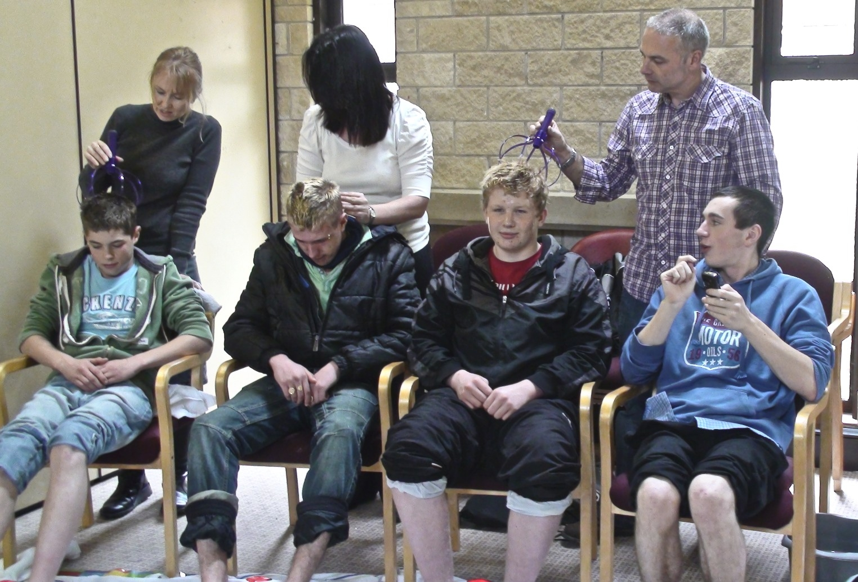
Example…..Lots of work with boys and young men

Slide 9
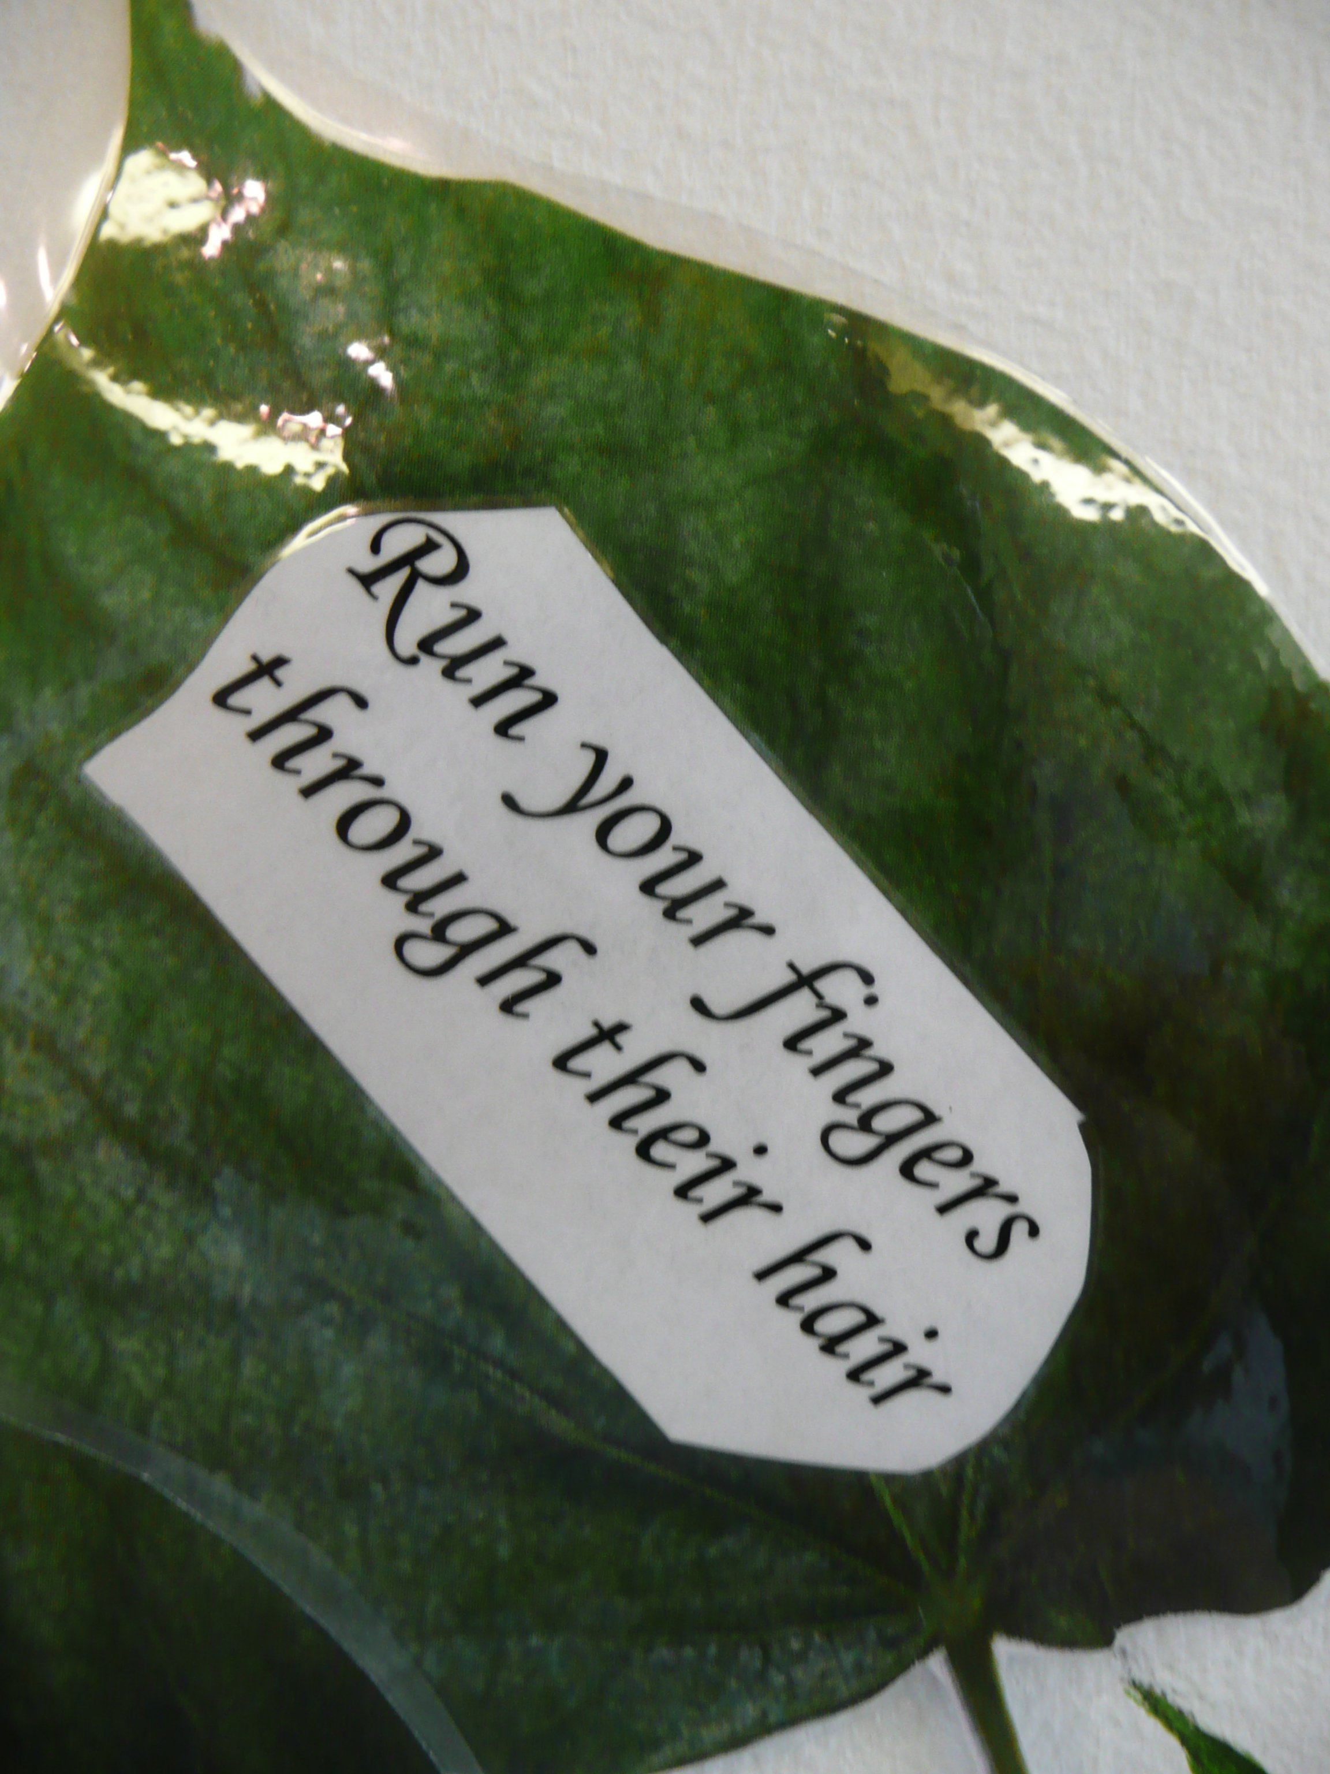
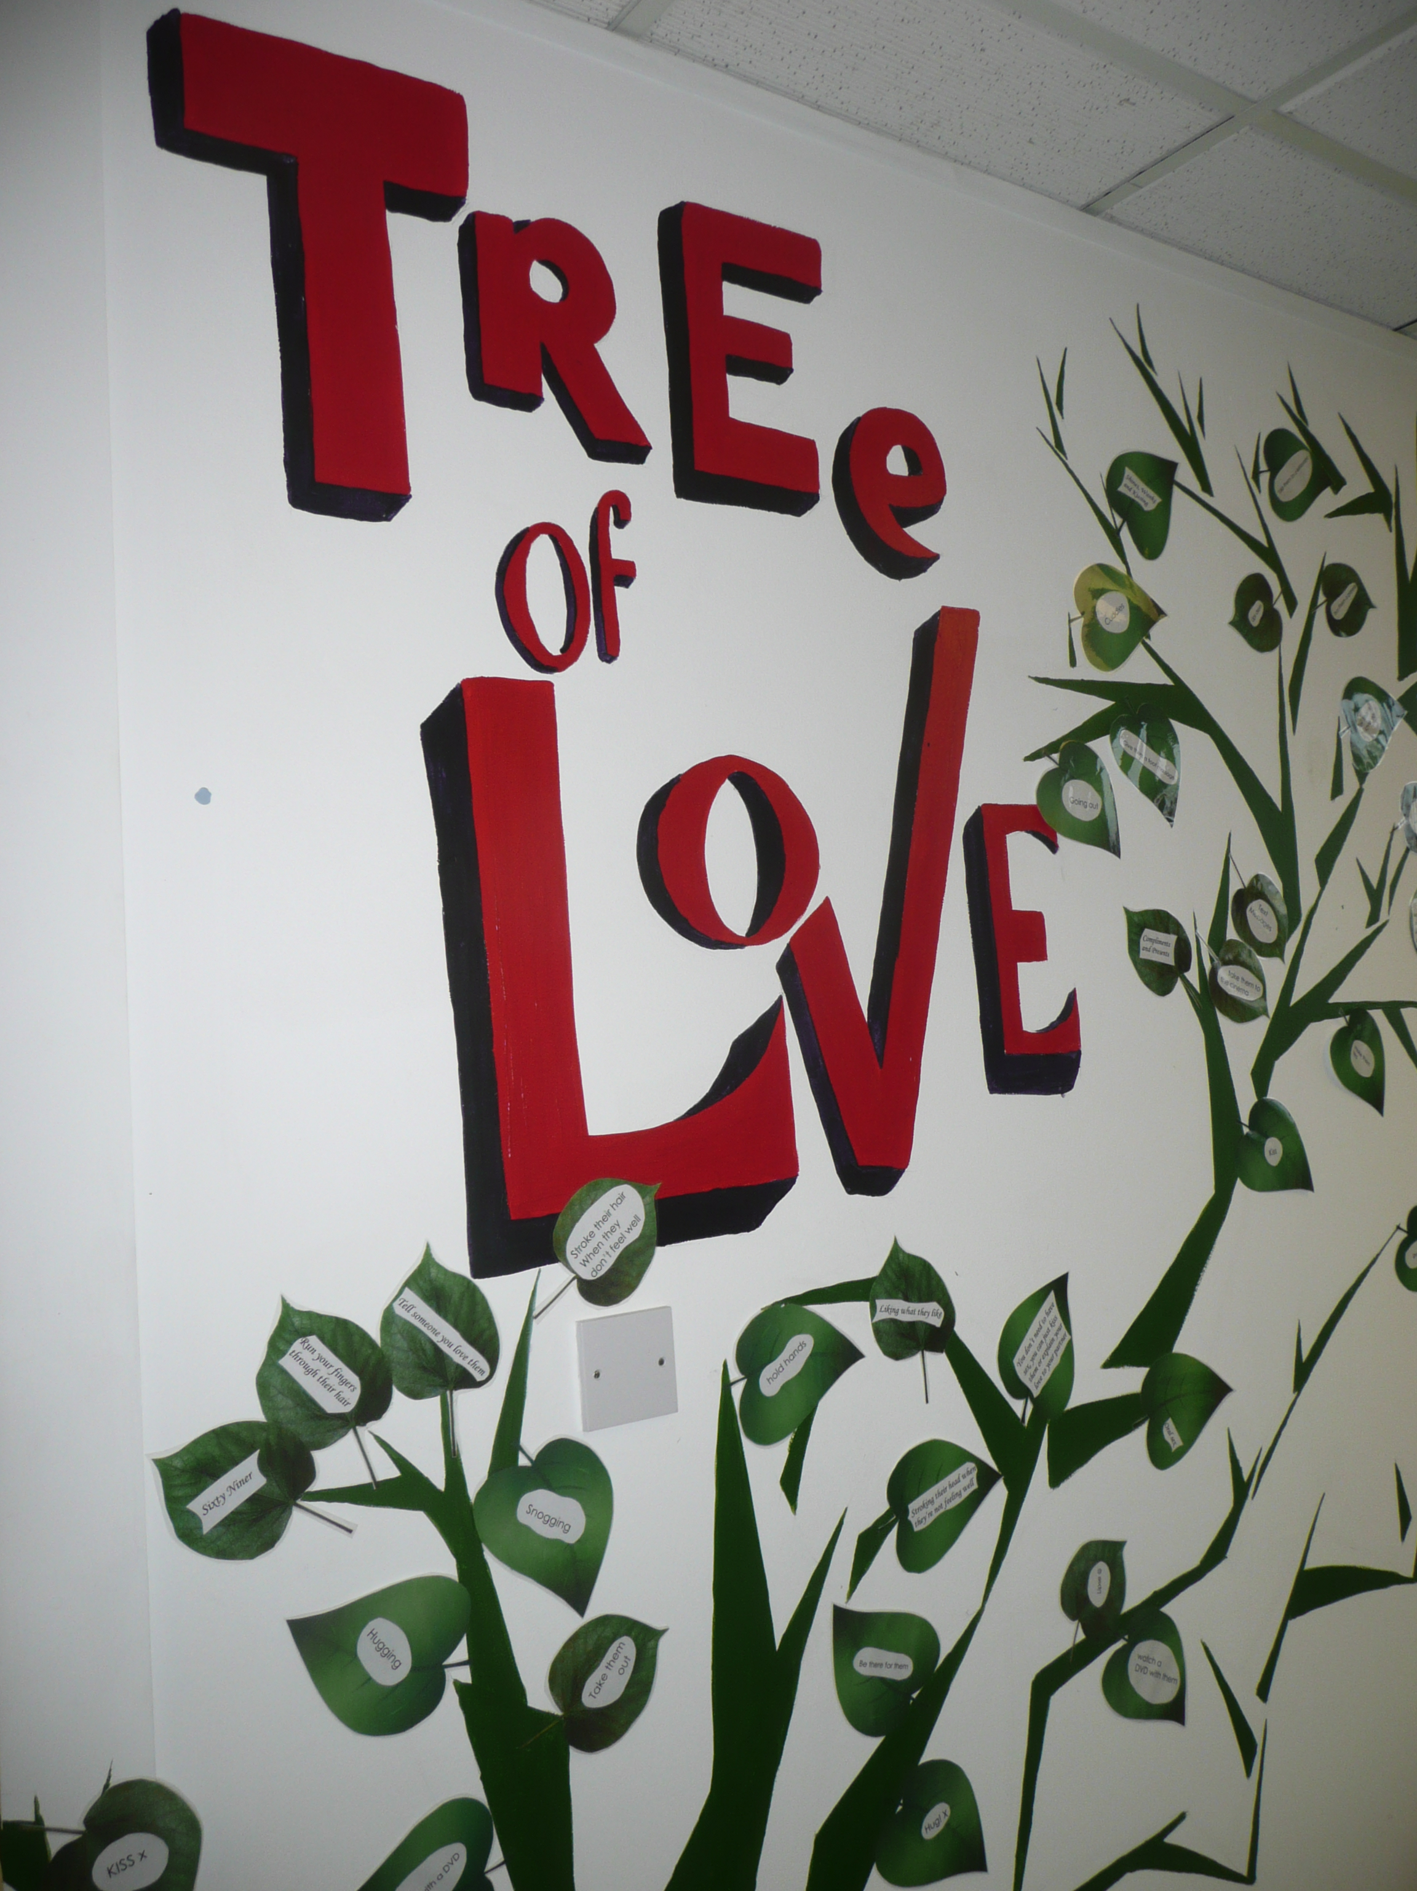
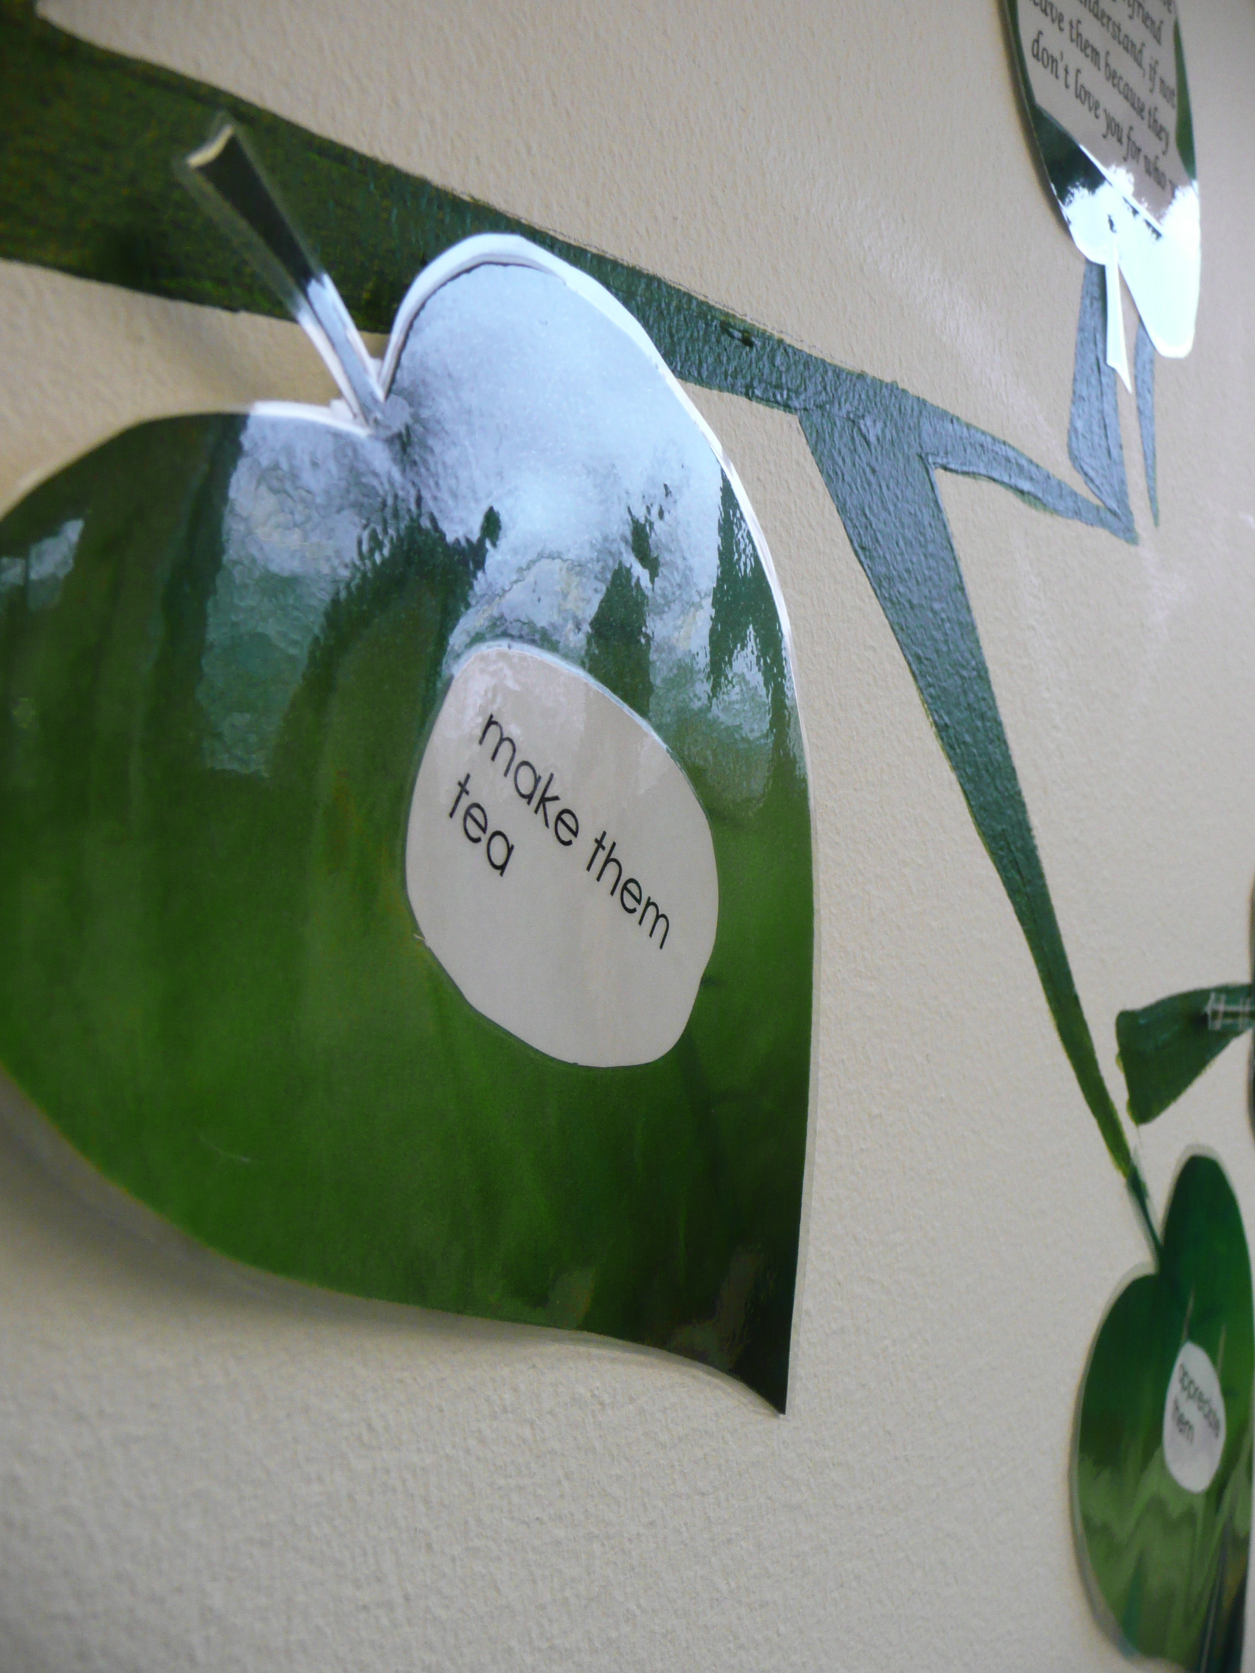

Slide 10
One thing we should give our children is roots,
The other is wings.
2 day training course – Relationships, sex and consent

