Slide 1
Smoking – understanding the habit and supporting young people to change.
Chris Freestone
Part 2

Slide 2
Part 2:
Stopping – is it possible?
How?
What may work
What can you do
Who else can be involved
Helping young people to manage withdrawal
Case study

Slide 3
habits
Remember how they form.
Your own habits / which ones should you break / priority order in terms of difficulty
Feedback

Slide 4
Breaking habits
This is hard ……………….how many of us have realised that when we diet , try to stop smoking , have to cut down on alcohol , chocolate etc
When and why does this work?
Why should it be any different for any young person?
What can we take from our own experiences and apply to working with the young people we care for?

Slide 5
Breaking a habit
A person may not be full aware of how a habit works- habits are built to make things happen without us having to think about them . Consciously intervening in our own behaviour won’t come naturally- breaking a habit needs consideration and effort
The brain is not likely to be used to scrutinising why a bad habit is carried out. Bad habits are also ingrained in the mind due to the rewarding feelings that they bring or perhaps used to bring , when the habit was formed.

Slide 6
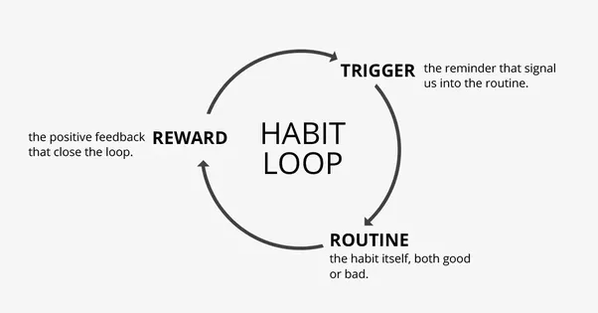
The habit loop……
Notes:
What could trigger the formation of this loop in our young people?
What would you consider good / bad habits to be ?
How will this vary with individuals and why may they not be able to see or understand the difference?

Slide 7
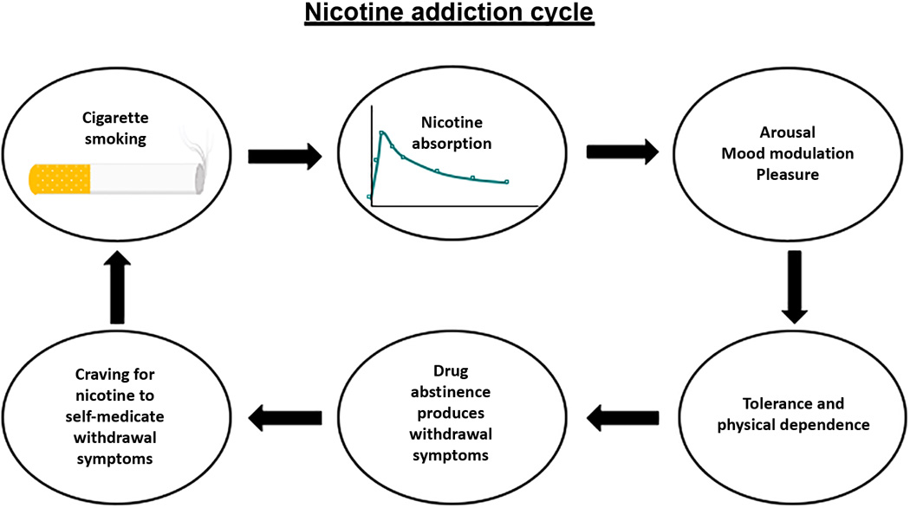
Notes:
Addiction is marked by the repeated, compulsive seeking or use of a substance despite its harmful effects and unwanted consequences. Addiction is mental or emotional dependence on a substance. Nicotine is the known addictive substance in tobacco. Regular use of tobacco products leads to addiction in many users. Nicotine is a drug that occurs naturally in tobacco and it’s thought to be as addictive as heroin or cocaine.

Slide 8
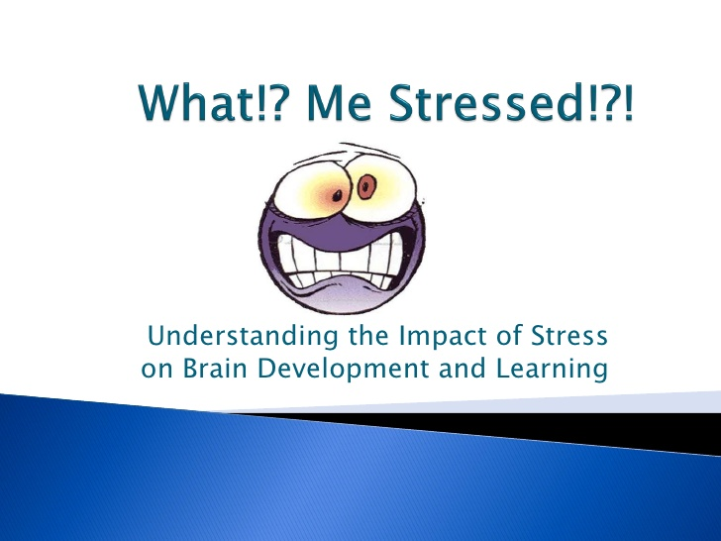

Next - moving from stress to calm…………………

Slide 9
Think about your home / service:
Other factors influencing the young person:
Peers/other young people in the home
Staff who may smoke
Environment in the home
Any others to take into account which are about the home ?
How can you minimise these factors ?

Slide 10
Stage 1- is it possible to stop smoking ?
Yes it is – but how?
The young person must WANT to stop.
How will you go about finding this out / encouraging them to stop- bear in mind they will probably already know it is not good for them
Why did they start?
The HSCIC (2015) survey conducted in 2014 also asked youngsters for their views on why young people smoke; those who were non-smokers believed their peers smoked to look cool in front of their friends (85%), because their friends had pressurised them into it (around 72%), or because they were addicted (70%). Young people who were regular smokers said they smoked to help them cope with stress (89%), because smoking gave them a good feeling (81%) and because they were addicted (79%) (HSCIC, 2015).
Notes:
Group to discuss ideas starting from the young person WANTING to stop- key factor

Slide 11
Stage 1
Find out why they started smoking- do these factors still exist? Have they changed? Have they also used / are using other substances?
Are they going through a particularly stressful period at the moment / starting to access therapy etc
How much do they already know about the impact of smoking?
If any factors exist which mean smoking has a key role in their lives at present what could SAFELY take its’ place?
Get this in place first – lecturing by the adult is seen by young people as a complete turn off!
Discuss this………….

Slide 12
Stage 2-
Know and share their reasons. Ask the young person to think about why he or she wants to stop smoking. ...
Set a quit date. Help them to choose a date to stop smoking.
Avoid temptation. ...
Be prepared for cravings. ...
Consider stop-smoking products. ...
Have support in place.

Slide 13
Stage 2…..
Ideas to help and support, have loads available- shaped to the age and stage of the young person:
you'll be healthier and less out of breath – smoking decreases your lung capacity.
You'll save yourself a lot of money. Help them to work out how much money you'll save by stopping smoking.
You'll look better. Chemicals in cigarettes restrict blood flow to your skin. Smokers have more wrinkled and saggy faces by the time they're in their mid-20s.
Quitting helps save the planet. Deforestation because of tobacco production accounts for nearly 5% of overall deforestation in the developing world.
Someone who starts smoking at 15 is 3 times more likely to die from cancer than someone who starts smoking in their mid-20s.
The younger you start smoking, the more damage there'll be to your body as an adult.
Not smoking will make you instantly more attractive. Most people prefer kissing non-smokers.
Smoking can harm your fertility and, if you're female, increases your chances of complications during pregnancy and labour. Smokers' babies are also more at risk of sudden infant death syndrome (SIDS).

Slide 14
Stage 2…….
Do incentives work ?
Are there issues in incentivising stopping smoking?
What incentives work best?
Discussion

Slide 15

Stage 3- How?
Stopping at once is the least successful method
Using a mixture of nicotine replacements works best- can be prescribed by a GP or nurse practitioner for 12-17 year olds. These include : gum , transdermal patch , inhaler, nasal spray and lozenges
Counselling can help as well

Slide 16
Stage 4- Being ready for some withdrawal symptoms
The most common symptoms include:
Having cravings for cigarettes
Feeling down or sad
Having trouble sleeping
Feeling irritable‚ on edge‚ or grouchy
Having trouble thinking clearly and concentrating
Feeling restless and jumpy
Having a slower heart rate
Feeling more hungry or gaining weight
WITHDRAWAL IS NOT DANGEROUS.
Cravings are odd and can occur weeks , months or years later. They occur with reminders of smoking , the habits which surrounded it and include people , places and things
What can you do to support the young person when they occur?
These symptoms are predictable – what will you do to help the young person deal with them?

Slide 17
Stage 4 continued…….
Nicotine is out of your body 72 hours after you quit smoking. Nicotine withdrawal symptoms usually reach their peak 2 to 3 days after you quit, and are gone within 1 to 3 months.
It takes at least 3 months for your brain chemistry to return to normal after you quit smoking.
The last two symptoms to go usually are irritability and low energy.
Any effective smoking cessation program has to take into account this long adjustment period. It is why some doctors recommend weaning off nicotine slowly with nicotine replacement therapy(NRT)
In summary, most people start to feel better after 1 week, and the symptoms are usually gone within 3 months

Slide 18
Stage 5- making a plan with the young person...
Having gone through stages 1, 2 and 3 and being prepared for stage 4 draw up a plan with the young person taking those stages into account. Take care when pulling a plan together that you do not overload the young person ( remember short term memory is only 6 plus or minus 2 items!!)
There will be common times / places / routines in the young person’s smoking habits- which are high risk . Identify those and put a compensation in place
e.g. drinking coffee, finishing a meal, using the phone, stressful situations, social events, peer group get together.
When you start your stop programme- make sure that the young person is supported to be busy or find an alternative at these high risk times
Avoid high risk occasions such as
- Don’t hang out with smokers. That’s like a crack addict hanging out with crack addicts. No matter how friendly and supportive their smoking friends are, they are still a high risk environment for at least the first several months.
- Help them to practice saying, “No thank you, I don’t smoke anymore.”
- Help them to understand that they will encounter high risk situations that you/they haven’t thought of. If they find themselves triggered, plan to get up and leave quickly.
- A change of scenery can make all the difference.

Slide 19
Stage 5 - focus
So, discuss the plan you will put in place with the young person:
Can they enlist their friends. Make a deal with good friends to quit. ...
Get them to talk to their GP. It's very hard to give up by willpower alone. ...
Prepare excuses. ...what may they be? Saving for a holiday , a moped etc
Get help with cravings. ...this is where you really come in to support! What is the plan?
Quietly help them to watch their weight. ...why?
Help them to set up a support network. ...who?
Help them to stay healthy. ...how?
Keep focused. Remind them about their replacement products – make sure they don’t run out, plan when they are needed , dates/ times of patch changes …….
Incentives and rewards………………what ?
Encourage the young person to quit smoking one day at a time.
Don't think about quitting forever. That can be overwhelming. Deal with right now, and the days will start to add up.

Slide 20
Going forward:
They will slip- everyone does! It is called being a human being!
What are you going to do to help them get back to their plan?
Help them to be kind to themselves , reinforce the positives .
Help them to see themselves as a non - smoker

Slide 21
CASE STUDY
Jon is aged 15 years and has smoked since he was 11 years old. He has experienced serious trauma within his birth family and has been in residential care since he was 13 years old.
At the moment he is smoking up to 12 roll ups a day including (you think ) in his bedroom. He does not seem to be using any other substance / alcohol at the moment.
Jon will frequently be missing from home returning with tobacco , he also returns with tobacco when he has seen his family.
At the moment Jon is refusing to engage with CAMHS or the therapist in the organisation.
He has a cough and does not eat well
DRAW UP A PLAN TO WORK WITH JON TO HELP HIM REDUCE/STOP HIS INTAKE OF TOBACCO.

Slide 22
CASE STUDY CONT’D
Small groups and feedback

Slide 23
Resources and information
https://smokefree.gov/get-extra-help
https://campaignresources.phe.gov.uk
https://www.nhs.uk
https://www.gasp.org.uk
https://www.ash.org.uk
https://www.cancerresearchuk.org/health-professional/awareness-and-prevention/smoking-cessation

Slide 24
Any questions or queries
Thank you.
Happy to help with any queries:
caf31.cf@outlook.com

