Slide 1
Smoking – understanding the habit and supporting young people to change.
Chris Freestone
Part 1

Slide 2
welcome
Aims of the sessions:
To understand how the brain works in the development of a habit
To understand the steps needed in order to change a habit
To be able to link this knowledge to the adverse childhood experiences and others which young people may have had
To be able to devise a smoking cessation plan with the young person and professionals

Slide 3
working together…
confidentiality
respect
diversity of opinion can be enriching
look for the benefits of an alternative opinion
positive challenge
naïve questions are valuable
ask for support if you want it
take responsibility for your own learning
enjoy ourselves

Slide 4
What young people say :
I know it is not good for me , but I can’t stop.
Why should I?
I can stop any time I want!
It’s nothing to do with you!
You don’t understand- I need it , it stops me thinking……
**Stopping is not as easy as it sounds……..
Notes:
Munro 3.17

Slide 5
What is smoking?
Using chat or microphone how do people “smoke” or otherwise use tobacco?
Notes:
ask for expectations in pairs

Slide 6
What/how do people smoke or use tobacco?
Cigarette
Cigar
Pipe
Hookah
Electronic cigarettes
Bidis
Kreteks
Chewed tobacco products include chewing tobacco, snuff, dip, and snus; snuff can also be sniffed.
Notes:
Bidi- small , thin , hand wrapped from India / S.east Asia
Kretek- tobacco and clove. MYTH- thought to be a healthy alternative- NOT!
Snus- moist , powder , smokeless tobacco inserted between lip and gum
Other addictive substances which can be smoked ?

Slide 7
Tobacco and a habit- how?
Habits and their formation are very complex .
They are managed by deep centres in the brain (Basal Ganglia)
When a habit is just starting to be learned these centres send impulses out throughout the “task” i.e. the steps in smoking
When the habit has been learned they only trigger at the start and end of the habit- helping to make sure that you complete the whole cycle.

Slide 8
Reflection….
We all have habits…..
Food
Exercise
Drinking
Smoking
Orders we do things
Take a few minutes to reflect and make a list of some of yours.
This is a personal reflection – to refer to during the day.
Think about whether your habits reassure you or make you anxious……

Slide 9
Tobacco and a habit- cont’d
Habits can he harmful or healthy
Why do we have habits?- they make us more efficient – no wasting time and energy making decisions
Can be “hijacked” by the use of addictive substances , eating unhealthy food
A new habit can take up to a little more than 2 months to form- 66 days (P. Lally. UCL) and as much as 254 days until fully formed.
These timescales are shortened when addictive substances are involved. e.g. spice causes an almost immediate addictive response
Habits form around a “habit loop”
Notes:
Harmful or healthy – examples?
Length of formation and ceasing a habit is longer again.
Spice- synthetic cannabinoids attach to the same nerve cell receptors as THC- mind altering constituent of marijuana. Attaches much more strongly! Usually contains other man made materials and a “cut”

Slide 10
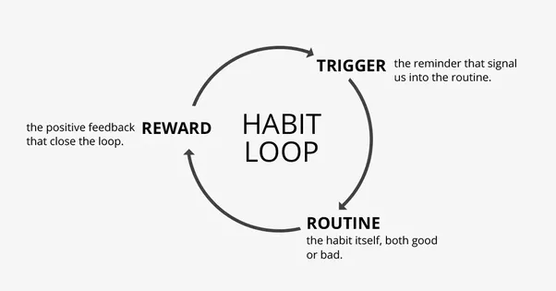
The habit loop……
Notes:
What could trigger the formation of this loop in our young people?
What would you consider good / bad habits to be ?
How will this vary with individuals and why may they not be able to see or understand the difference?

Slide 11
What happens in the brain when tobacco is used ……
Tobacco contains nicotine- first classified as a “poison” ……!
Tobacco is smoked/ingested in some form
Crosses into the bloodstream- lungs are very rich in blood vessels as is the mouth
As other addictive substances it impacts the brain- with the production :
-of dopamine – plays a key role in how we feel pleasure
-of serotonin- contributes to well being and happiness
-of adrenaline
Notes:
From the nightshade family

Slide 12
What happens in the brain when tobacco is used….
the “buzz”, pleasure and energy are short lived and are then replaced by edginess and irritability- withdrawal symptoms
So….. You repeat the action to get the “buzz”
One cigarette = 1-2mg nicotine
Tolerance to nicotine levels sets in quickly, so smokers have to increase the number of cigarettes they have to get the same “buzz” until a level of equilibrium is reached.
The problem is nicotine is addictive
Notes:
Addiction is marked by the repeated, compulsive seeking or use of a substance despite its harmful effects and unwanted consequences. Addiction is mental or emotional dependence on a substance. Nicotine is the known addictive substance in tobacco. Regular use of tobacco products leads to addiction in many users. Nicotine is a drug that occurs naturally in tobacco and it’s thought to be as addictive as heroin or cocaine.

Slide 13
What is an addiction?
Addiction is marked by the repeated, compulsive seeking or use of a substance despite its harmful effects and unwanted consequences. Addiction is mental or emotional dependence on a substance. Nicotine is the known addictive substance in tobacco. Regular use of tobacco products leads to addiction in many users. Nicotine is a drug that occurs naturally in tobacco and it’s thought to be as addictive as heroin or cocaine.
Notes:
Other addictions?
Pseudo addictions?

Slide 14
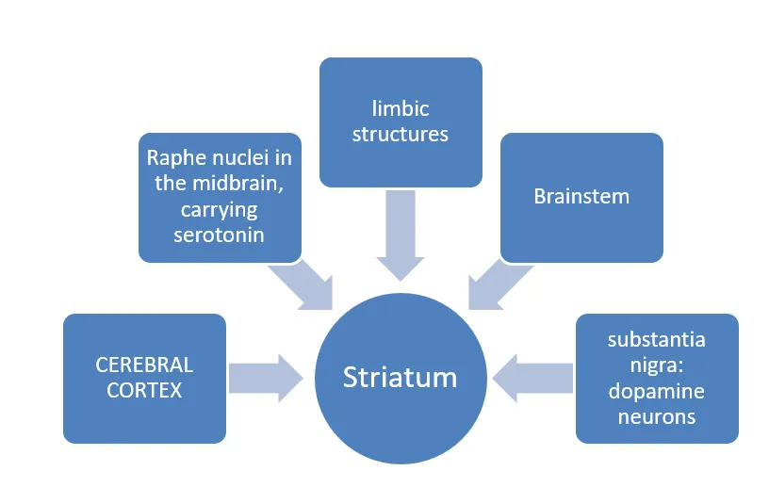
Cycle and actions within the brain
Notes:
Serotonin-contributes to well being and happiness
Limbic structures- emotions, memory and reinforces behaviour
Dopamine- helps us think plan and feel pleasure

Slide 15
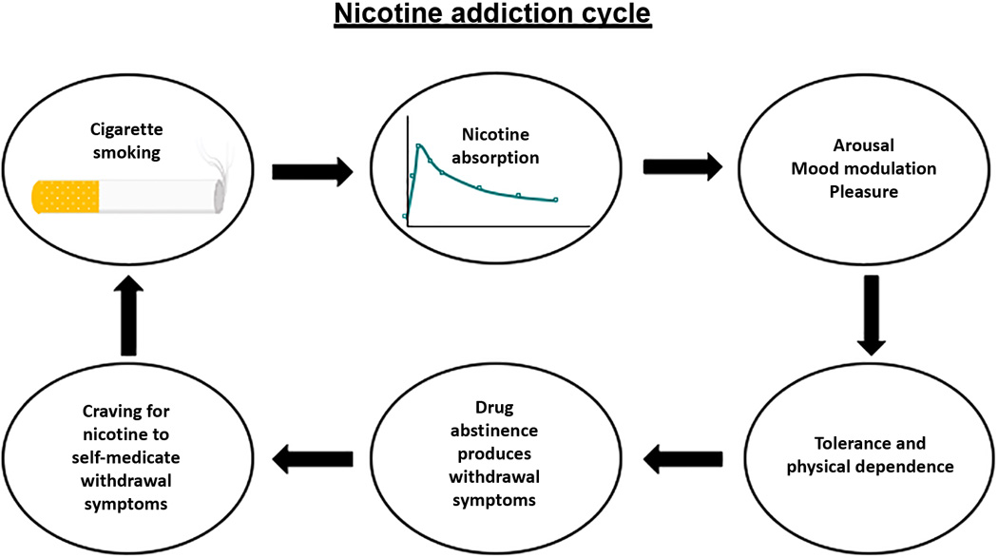
Notes:
Addiction is marked by the repeated, compulsive seeking or use of a substance despite its harmful effects and unwanted consequences. Addiction is mental or emotional dependence on a substance. Nicotine is the known addictive substance in tobacco. Regular use of tobacco products leads to addiction in many users. Nicotine is a drug that occurs naturally in tobacco and it’s thought to be as addictive as heroin or cocaine.

Slide 16
Why do young people start smoking?
In your breakout rooms spend some time talking about the reasons why young people may start smoking?
Why may smoking seemingly “help” our young people?
Nominate one person to feedback
Notes:
Peer pressure
Cool
Wanted to try it
Parents / family habit
Bullying
Rebellion
Coping with stress
Sense of belonging
USA – 9/10 start in their teens
Influence of media?

Slide 17
Why is a habit so hard to break?
Usually habits are there so that things can happen without us thinking about it.
Consciously seeking to change this (think New Year resolutions!!)does not come naturally- it needs consideration and effort
So habits are your behaviour on auto pilot- good and bad habits bring feelings of reward…..thus very difficult to break.
Most of the time our feelings that we “should” change are overridden by the “reward.”
Notes:
So lecturing a young person is not going to work!

Slide 18
Part 2
We will look at :
Stopping – is it possible and how?
What may help/work?
Who may be involved
What can YOU do ?
Managing nicotine withdrawal
Case study-optional
Notes:
Case study if you wish to do it and return to me for a peer review 28.8.20

Slide 19
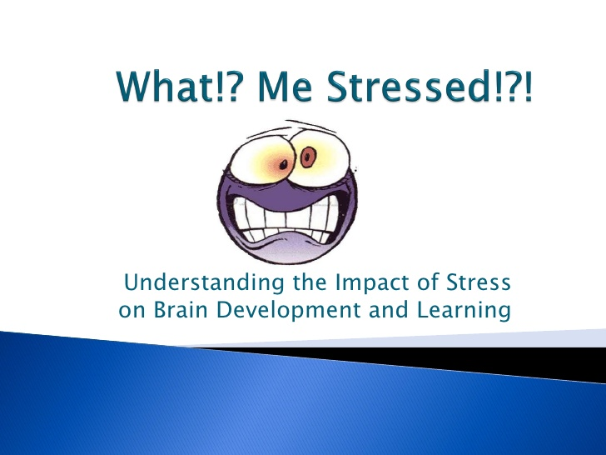

Next time- moving stress to calm…………………

