Slide 1
Leadership and distributed leadership – setting and testing your culture.
October 24th 2022.
RI CPD
Chris Freestone

Slide 2
working together…
confidentiality
respect
diversity of opinion can be enriching
look for the benefits of an alternative opinion
positive challenge
naïve questions are valuable
enjoy ourselves- lots of conversation I hope !

Slide 3
aims
- to all reflect upon how you secure and test the leadership culture in your service, enabling a distributed leadership model to work more effectively
gaining the hard to quantify evidence
confirming it from an RI perspective
Notes:
Munro 3.17

Slide 4
Language of the O/S criteria in the SCCIF……all about leadership
Leaders and managers are inspirational, confident and ambitious for children and influential in changing the lives of those in their care.
Leaders and managers create a culture of high aspiration and positivity. They have high expectations of their staff to change and improve the lives of the children they are responsible for.
Leaders and managers lead by example, innovate and generate creative ideas to sustain the highest quality care for children.

Slide 5
Language of the O/S criteria in the SCCIF……all about leadership
Leaders and managers know their strengths and weaknesses well and can provide evidence of improvement over a sustained period.
Leaders and managers have working relationships with partner agencies and schools that ensure the best possible care, experiences and futures for children
These criteria are grounded in leadership and how this is expressed in the culture of your services…….

Slide 6
Culture is……………
about leadership
about connections
about communication
fundamental
a positive model
a positive model of behaviour which is shared, known and understood by the team
shared vision
common beliefs, values and actions
CULTURE IS WEAKER WHEN CONNECTIONS ARE POOR OR INFREQUENT
Notes:
Is this a reflection of your culture – whole school and / or safeguarding culture?

Slide 7
A good culture arises from messages that promote traits like collaboration, honesty, trust and hard work and include:
Fundamental beliefs and assumptions, or the things that people in your home consider to be true.
Shared values, or the judgments people in your service make about those belief and assumptions.
Norms, or how staff believe they should act and behave, or what they think is expected of them

Slide 8
A good culture continued…
4. Patterns and behaviours, or the way people actually act and behave in your home / service.
5. Tangible evidence, or the physical, visual, auditory, or other sensory signs that demonstrate the behaviours of the staff in your service.
Each of these components influences and drives the others, forming a circle of reinforcing beliefs and actions
IS THIS YOUR SERVICE?

Slide 9
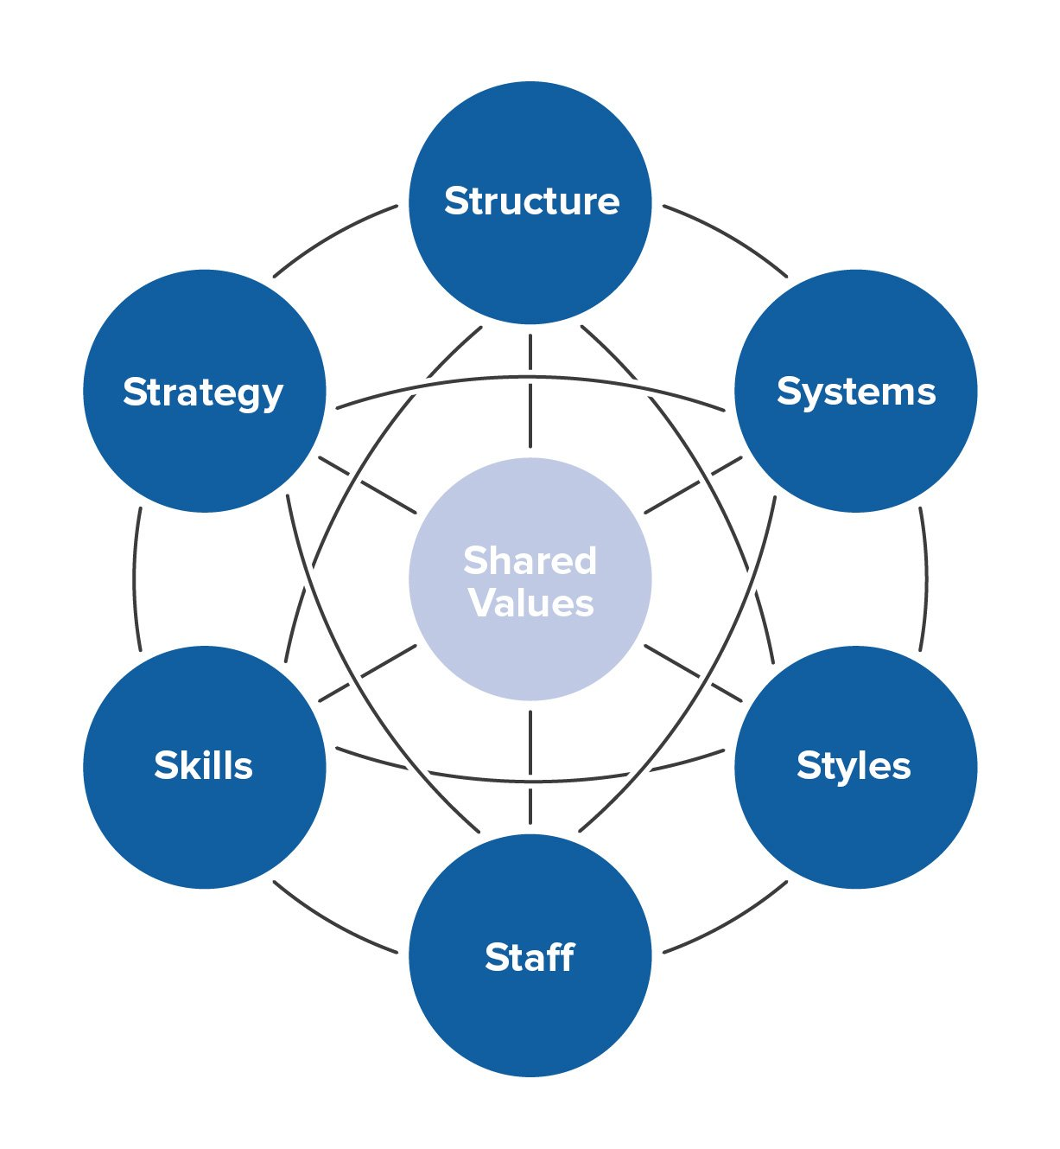
Culture Structure – McKinsey 2016

Slide 10
Are these protective factors in place in your service and your home? These can all be tested …..
strong leadership
safer recruitment- robust and monitored
positive staff culture
close inclusive relationships with young people
high quality supervision / appraisal
effective monitoring and placement review
good interagency communication
use of LADO

Slide 11
Protective factors
child centred, rights based approach
calm, authoritative staff, with strategies to respond
up to date training which aligns with the Statement of Purpose and practice
challenge and whistleblowing
clarity in hearing the child’s voice throughout
external view and challenge
professionals input

Slide 12

Culture:
Data
Accidents / incidents
Interventions
Regulation 40
Reg 45 findings
Reg 44 findings
Complaints
Health and safety
ANYTHING ELSE?
The VOICE of the child- central!

Slide 13
Setting , recognising and testing the culture ……
… makes distributed leadership far more likely to succeed- this is what you want .
The key is to remember that distributed leadership is not initially about delegation…..
It is a wider process which can help with issues such as succession planning- a key issue in the current recruitment crisis, can improve staff motivation and morale – but are you and the RM ready to do this ?

Slide 14
Distributed Leadership
Autonomy
Capacity
Accountability

Slide 15
Distributed leadership – making it happen
Is your culture secure, tested and embedded?
giving autonomy - no micro managing, built on earned trust
accountability – held to account for outcomes but with some space for reflection and learning
capacity – giving support and help in exercising a leadership role
shift from rules to parameters

Slide 16
The role of the Manager in making it happen……
supporting staff
holding individuals accountable
building capacity
ensuring collaboration and co-ordination
How does the RI support this process?

Slide 17
Distributed Leadership the problems -
relationship with Manager
lack of support or capacity
unclear lines of accountability
not clear about expectations
no systems or structure for wider participation
too many parameters
How does the RI identify these issues ?

Slide 18
Why is this approach a positive model ?
ensures that decision-making responsibilities are shared
improves teamwork, promotes flexibility in roles
promotes collaborative working within a culture , vision and values which everyone understands
promotes individual and joint accountability
boosts individual and team morale
empowers individuals
gives the Manager some capacity for other areas – development , strategy etc.

Slide 19
Why is this approach a positive model ?
models a positive style to children and young people
improves practice
improves relationships with children and young people
should improve outcomes for children and young people-something we ALL strive for .
Can you as the RI prove this ?

Slide 20
From your perspective ….
Are you comfortable with this ? Is the RM?
Is the current culture , leadership and management styles ,sufficiently robust and secure in order to roll out this model?
Is there a secure culture of mutual trust and respect ?
ANY OTHER THOUGHTS?

Slide 21
Small group work
What may be the barriers to using a distributed leadership model in your home ?
Have you already got this in place ?Does it work for you ?

Slide 22
Q&A
any other issues and thoughts ?

Slide 23

Thank you.

