Slide 1

SOUTH WEST SUFFICIENCY PROJECT

Slide 2
Objectives
The project is two fold; looking at how LA’s can work more efficiently with the independent sector and how LA’s can commission, design and deliver services together.
To create a whole system approach; creating new models for commissioning that will compliment all existing models and give Local Authorities increased levels of sufficiency.
Establish new ways of working, to improve partnership working between Local Authorities, Independent providers, and agencies across the South West Region.
To improve placement sufficiency by placing children in Local high-quality placements at a sustainable cost for the LA’s and the independent sector.
Notes:
Tamsin

Slide 3
Key Deliverables
Produce a needs analysis to include an understanding of the market and aggregation of data to inform equality decisions.
Produce one market position statement for residential, fostering, and non-maintained independent special schools.
Develop recommendations for new ways of delivering services including new ways of partnership/ working across LA’s.
Notes:
Tamsin

Slide 4
Data Capture
Analysis
MPS
Recommendation
Paper
Programme
of Work
Priorities
Recommendation Paper Gateway & Programme Design
Recommendation Design
Programme Starts
June
July
Aug
Sept
Oct
Programme Design
& Project Close
Recommendation Design
Phase 4
Phase 5
Notes:
Tamsin

Slide 5
The majority of children in the South West are in care because of
‘abuse or neglect’ (63%),
with family dysfunction (12%)
‘family in acute stress’ (10%)
The age profile of children in care in the South West is similar to other regions
aged 10 to 15 years (41%)
16 or 17 year olds (25%)
This profile has changed little over recent years.
There has been a marked increase in the number of children aged under 11 in residential care with the number of girls rising.
There were 154 more children aged between 5 and 11 in residential care in 2021 than in 2018, a 31% increase.
Greater complexity of needs at younger ages may be a factor but it is more likely to reflect a shortage of appropriate foster homes.
MPS Highlights
Notes:
Ross

Slide 6
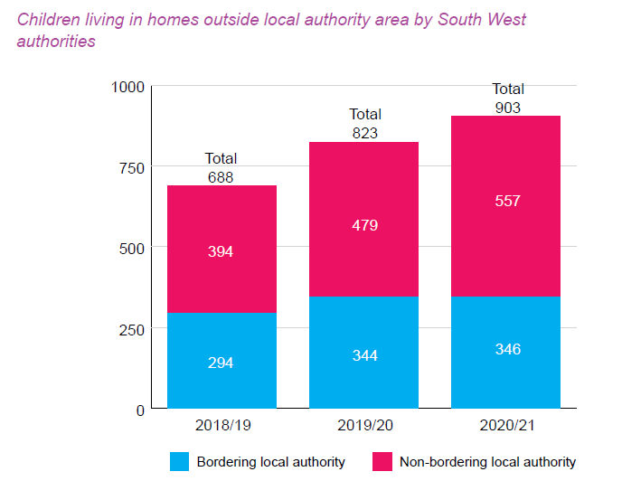
For hard to place C&YP three themes came up repeatedly:
Children with mental health problems manifesting in self-injurious behaviours or suicidal ideation
Children who have been subject to criminal exploitation, such as ‘county lines’ or sexual exploitation
Children with multiple needs, sometimes including autism or learning disabilities alongside other needs
MPS Highlights
The number of children placed more than 20 miles from their home has increased significantly. The South West has the second highest proportion of any English region (31%)
Notes:
Ross

Slide 7
To build a solid foundation the programme has prioritised the following:
Encourage and support regional partnerships through a commissioning network project
  Develop and sustain a regional approach to sharing best practice and problem solving
  Build and sustain local provision through partner arrangements to increase local specialist and complex needs (tier 3.5) provision
Build same day provision with with opportunity for assessment including a wrap around support model
Design a new and improved purchasing system for SEND
Develop provision to support emerging 5-12 C&YP with complex needs; Therapeutic Treatment centre.
Develop a workforce strategy
Develop a system that supports data led decision making with the support of a single outcome-based referral process for the region
PROGRAMME OF WORK
Notes:
Tamsin

Slide 8
Sector Led Improvement Board
Sponsor
Chris Sivers
Programme Group
Programme Strategic Leads – Ross Chick, Alison Stone
Programme Manager – Tamsin Cullum
Specialist Programme Leads – Julie Breeze, Olwyn Donnelly, Hugh Disley, Ian Tomlinson, 1 x fostering VACANT, 1 x Residential VACANT
Regional Coordinator – Vicky Rasey
Regional Administrator – 1 x VACANT
Associations – NAFP/CHA/NASS
Somerset
Consultant and Gloucester
?
Programme Team and Associations
?
North -Somerset
REGIONAL
PROJECT 1
Sourcing Sufficiency
REGIONAL
PROJECT 2
Workforce Strategy
REGIONAL
PROJECT 3
SEND New Purchasing System Pilot
REGIONAL
PROJECT 4
Commissioning Network
SUB-REGIONAL PROJECT 5
Therapeutic Treatment Centre 6-12 years of age
SUB-REGIONAL PROJECT 6
Same Day Provision with opportunity for assessment and wrap around support
Notes:
Tamsin

Slide 9
PROJECT | ABOUT
Sourcing Sufficiency | To improve regional sharing and intelligent use of data; to better understand sufficiency issues and, plan for future demand in terms of need and provision. To support we will develop a clear and consistent outcome based regional referral form and investigate placement finding opportunities.
Workforce Strategy | This project will develop a regional workforce strategy for residential, foster care and special school staff.
Commissioning Network | This project will lead on sharing best practice, find solutions to challenges and, build and sustain relationships across the region. There will be focus workshops on designing models, working with Ofsted, developing relational commissioning/partner agreements and ultimately bridging the learning across regional networks.
Purchasing System Pilot | This project will investigate developing a new and improved purchasing system for special schools.
Therapeutic Treatment Centre (5 -12 years of age) | This pilot sub-regional project will support young children (ages 6 – 12) who have experienced trauma, neglect, physical, emotional and sexual abuse to grow socially and emotionally and learn to cope with school and everyday life and wherever possible, to return to full-time carers and day schools before they reach their teenage years. The centre will be a 52 week residential special school assisting all trauma and therapeutic informed training and support for the sub-region.
Same Day Provision with opportunity for assessment & wrap around support | This pilot sub-regional project will look to develop short term emergency provision with assessment opportunities based on North Yorkshire’s ‘No Wrong Door’ model. C&YP will be supported in a safe environment whilst a permanent home is found. This will largely support our more complex/hard to place C&YP. We will look to pilot at a sub-regional level and then roll out across the region. We will look to create a service support collaborative model/way of working. This agreement will be built on relationships and provide wrap around support with health, education, social care and police, commissioners, local safeguarding partnerships, and providers. This will look to include foster carer support with ability to carry out assessment.
Notes:
Tamsin

Slide 10
Semi & Independent Living
Fostering and Residential
Planned
Support Network
Fostering
Mockingbird
Assessment
Placement finding
Planned Short Stay
(No Wrong Door)
Long Term Provision
Residential
?
Referral Events
Un-Planned
Same Day Provision with assessment and wrap around support
Placement Breakdown
Notes:
Tamsin

Slide 11
Open discussion to influence the SW Workforce Strategy
What attracted you to the sector
Recruitment
Training
Retention
Career pathway
Pressures
Ofsted
Innovative Ideas
Workforce Strategy
Raise the profile of working in the care sector
Increase in a highly skilled workforce
Increase retention
Notes:
Ross

