Slide 1
Local Authority Designated Officer
Managing Allegations
Southwest Regional LADO Group
2025
Notes:
Karen

Slide 2
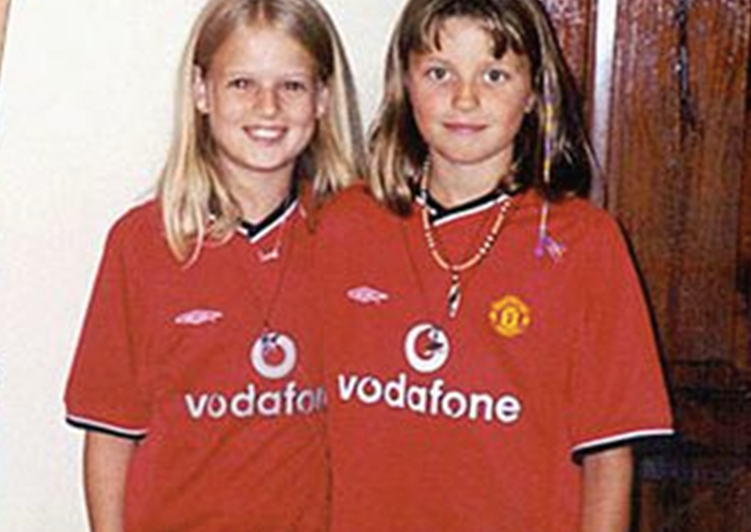
People who work with children
‘Everyone who works with children has a responsibility for keeping them safe. Everyone who comes into contact with Children has a role to play in identifying concerns, sharing information and taking prompt action’.
Working together to safeguard children 2023
Notes:
Karen
The managing allegations procedure came about following the tragic deaths of Jessica Chapman and Holly Wells. // The photo you can see is the last photo of them alive. Later that day they would be murdered by the partner of their teaching assistant at school, this person was also a care taker at the local secondary school.
The public enquiry that followed introduced significant changes to how people are recruited into positions of trust working with children and young people. This includes the importance of reference checking and of course DBS checks.
Additionally it led to the introduction of the managing allegations procedure and the creation of the Local Authority Designated officer role, also known as LADO. The allegations management procedure has been developed to deal with allegations of inappropriate behaviour made against people who work with children. This will range from police officers, teachers, social workers, sports coaches, faith leaders in other words every body who works with children in either a paid or voluntary capacity.
Contextual safeguarding – go to for children and young people who have suffered significant harm outside of the family environment.
Let us now look at the specific responsibilities for employers and the LADO

Slide 3
Local Authority Designated Officer
LADO
Receive reports about allegations and to be involved in the management and oversight of individual cases;
Liaise with the police and other agencies;
Monitor the progress of cases to ensure that they are dealt with as quickly as possible consistent with a thorough and fair process
Provide advice and guidance to employers and voluntary organisations
Notes:
Karen
CLICK
Every Local Authority will have a LADO service and it is to this service that you should be making a notification by completing the allegations reporting form and sending this to Somerset Direct. Somerset Direct is Somerset Council’s first point of contact for the public to access services to safeguard children. The details for how to contact Somerset direct are included in the slide.
As I have already mentioned it is a statutory requirement that the LADO service is contacted within one working day.
CLICK
Depending on the seriousness of the allegation it may need the involvement of the police and / or Children’s Social Care. It is for the LADO to liaise with these agencies to determine if there is a need for either to become involved, and to inform your organisation.
CLICK
Because of the anxiety that is likely to be felt by your member of staff or volunteer it is important that any form of investigation to deal with the allegation is concluded as quickly as possible. Therefore, the LADO has the responsibility to monitor progress so that there is not drift.
Your organisation needs to keep the LADO frequently updated on progress on any organisational investigation you have been advised by the LADO to undertaken. At the conclusion of the investigation you must inform the LADO of the outcome and provide a copy of the investigation report.
CLICK
The LADO is expected to provide your organisation with advice, guidance in dealing with the allegation. The allegations reporting form does allow you to seek advice and guidance if you are not sure the criteria to trigger the managing allegations procedure is met.
We will know take a look at the four criteria that would trigger a notification to the LADO.

Slide 4
So, what is an Allegation?
behaved in a way that has harmed a child, or may have harmed a child
behaved towards a child or children in a way that indicates they may pose a risk of harm to children
possibly committed a criminal offence against or related to a child
behaved, or may have behaved, in a way that indicates they may not be suitable to work with children
Notes:
Rosie-
Allegations, complaints and quality of care concerns are all serious however there are different processes to deal with each. The process we are talking about today is the management of allegations.
For instance, an allegation against an employee or volunteer is not the same as a concern about the quality of care or service that the child / young person is receiving… nor is it the same as a complaint about your employee’s practice.
Let's say a parent complains that their child is not being set enough homework by their teacher, and feels this is hindering their learning, this is not same as allegation that their child is being harmed in some way.
There are four criteria that determine if inappropriate behaviour by your member of staff is in fact an ‘allegation’. Only one of the four needs to be met in order to notify the LADO, in the most serious cases all four of the criteria I am about to show you could be met.
Let's take a look at the first criteria (first criteria pop up) does the alleged inappropriate behaviour indicate that a child has been harmed? What do we mean by ‘Harm’?
Well, for those of you who have completed a basic child protection training, you’ll recall that there are four types of harm that the legislation refers to – sexual harm / physical harm / neglect / emotional harm. An example of the first ‘criteria’, might be an allegation that your employee is grooming the young person – perhaps contacting the young person on social media like Facebook. If they were being groomed although they haven’t yet been harmed…they might be harmed in the future if the professional has a sinister motive.
The second criteria is (second criteria to pop up) is where the alleged inappropriate behaviour is possible a criminal offence against or related to the child.
For instance, the young person is inappropriately restrained by your member of staff and is hurt in the process. Unless the restrain is deemed reasonable and proportionate it may be deemed as a physical assault.
The third criteria (Pops up) is where the alleged inappropriate behaviour indicates an immediacy of risk to the child or others. For instance, if a scout leader has sexually assaulted a child, then there is an immediacy of risk to not only the victim but to all children in that setting.
And finally, the fourth criteria (pops up) which has been designed to address alleged inappropriate behaviour outside the workplace where there may be a transferability of risk into the work setting. For instance, if your employee was a perpetrator of domestic abuse, the risk would be that they may have a volatile and violent temperament which could impact on their professional relationship with children and young people in their work setting.
If one or more of these criteria are met there are up to three process that might come into play to investigated the allegation, let's have a look at these.

Slide 5
What is Harm?
Sexual
Physical
emotional
Neglect in Duty of Care
Notes:
Rosie
Suitability and transferable risk
Not always an allegation of harm to a child-

Slide 6
The Harm Test
What is the harm test?
A person satisfies the harm test if they may harm a child or vulnerable adult or put them at risk of harm. It is something a person may do to cause harm or pose a risk of harm to a child or vulnerable adult.
Notes:
Rosie

Slide 7
 | Accidental | Reckless | Deliberate
Physical | A member of staff collides with a young person when walking out from the living room, and the child alleges this was intentional. | Member of staff physically must restrain a child, however they use an unapproved physical hold. No harm was caused, but the child complained about being restrained. | Young person is physically and verbally abusive to a member of staff, the member of staff pins them to a wall and shouts in their face.
Sexual | Walking past a young person on the stairs, the member of staff brushes the Young Persons bottom with their hand. | Member of staff does not knock on the Young Persons door before entering and the Young Person is naked. | Member of staff arranges to meet the young person outside of working hours and contacts them on their personal number and asks the young person to send naked pictures of themselves.
Emotional | Member of staff refers to a young person with the incorrect pronouns | A black Young Person reports the registered manager is calling them a cheeky monkey and the young person feels this is racist. | Member of staff repeatedly shames a trans young person for the clothing they are wearing. Telling them “ you can't wear that” “you look like a poof” this is done in front of other young people and staff
Neglect (in duty of care) | Care home not fully staffed and an issue arises which means that a young person's medication is administered late. | Speeding when transporting a young person | Member of staff locks the young person in a room and refuses them any food in response to the child having been abusive.
Notes:
Karen and Rosie

Slide 8
Preliminary Fact Finding
Establish the facts
Quick and timely – to ensure a LADO referral is completed within 24 hours
Detailed written account from person reporting the concern
Do you have a full understanding of what happened
Context of concern - where and when did it happen
Are there any witnesses
CCTV
Speak with the Child or Young Persons Social worker
Discuss with Senior Manager
Do you have any previous concerns about the member of staff
What is the Child or Young Persons view
Has the young person told anyone else
Notes:
Karen

Slide 9
Preliminary Fact Finding
Were there any witnesses?
Ask the witnesses what they saw?
What is the Child or Young Person's history regarding making allegations?
Ask the Child or Young person to demonstrate what happened
TED- Tell - Explain -Describe
Tell me what happened?
Can you tell me where/when this happened?
who was involved?
Who was close by / saw what happened?
Notes:
Karen

Slide 10
Managing low level concerns
Farrer and Co; Developing a Low-Level Concerns Policy
Record keeping is essential
Record and evidence who you have discussed the concern/allegation with and joined up decision making (Social Worker/Manager/HR)
Evidence decision making and rationale regarding how the concern has been dealt with and actions taken by your organisation
Notes:
Rosie

Slide 11
Patterns of Low-Level Concerns
Create a chronology where there are number or pattern of concerns regarding a staff member
Record on staff members file so this can be reviewed in supervision/performance reviews
When a pattern of concerns is identified a formal course of action should be decided; either through disciplinary procedures or referral to the LADO
Notes:
Rosie

Slide 12
Possible Options
LADO referral (clearly meets LADO threshold / harm test)
Doubt-it may meet harm test - consult with LADO
Low level concern (harm test not met)
Behaviour is appropriate and consistent with code of conduct
Familiarise yourself with the LADO service in the area where you work and the process you will need to follow.
Notes:
Rosie
The making of an allegation in its own does not always warrant referral to LADO.
Serious allegations should be referred immediately.
Use professional judgement

Slide 13
Reporting Allegations
Context
Demographics
LADO criteria
Notification to the LADO made within ONE working day
Notes:
Rosie – Process of completing a LADO notification – details of the context, Demographics, why the threshold has been met.

Slide 14
Allegation Management
A police investigation of a possible criminal offence;
Children's social care enquiries and/or assessment about whether a child is in need of protection or services;
Organisational investigation
The LADO does not investigate allegations.
Notes:
Karen-
When threshold is met- for AM (different LA call it something different- AM, Initial allegation evaluation meetings/Post allegation management meeting, risk management meetings,
A note on strategy meetings.
There are up to three strands in the consideration of an allegation, when considering which of the three process to pursue will be dependant upon the nature of the allegation.
A police investigation of a possible criminal offence;
Children's social care enquiries and/or assessment about whether a child is in need of protection or services;
Organisational investigation
Childrens care team is responsible for the decision around a strategy meeting and calling this if threshold for significant harm is met and LADO should always be invited. LADO’s do this differently around the country, however here in Somerset we hold AMM – Strategy meetings are called and arrange by the child care team as they have responsibility for the child’s welfare/care.
An example would be an allegation that your employee when off duty has been accessing indecent images of children on their computer. In this instance it is likely all three of these process would come into play.
As previously mentioned it is the responsibility of the LADO, not the employer to liaise with the police and children social care to determine if there is a role for either agency. If there is an immediate risk of harm to a child then you as an organisation should be contacting the emergency services on 999.
Where the LADO is advising an organisational investigations, you should always seek advice and guidance form your HR provider and throughout the process keep the LADO regularly updated, and at the end of the process provide the LADO with a copy of the investigation report and confirm the outcome.

Slide 15
Communication
The LADO will identify an individual who is responsible for keeping the child, parents and the person who is being investigated updated.
The employer is responsible for updating the LADO with any progress and new information if relevant.
Children and Young People’s views are important and should be considered throughout the Allegation Management process.
Notes:
Karen
In the most serious of cases this may require a DBS referral/Ofsted informed.

Slide 16
Outcomes
Substantiated: there is sufficient identifiable evidence to prove the allegation;
False: there is sufficient evidence to disprove the allegation;
Malicious: there is sufficient evidence to disprove the allegation and there has been a deliberate act to deceive;
Unsubstantiated: this is not the same as a false allegation. It means that there is insufficient evidence to either prove or disprove the allegation; the term therefore does not imply guilt or innocence.
Unfounded: The term ‘unfounded’ means that there is no evidence or proper basis that supports the allegation being made.
Notes:
Karen
In the most serious of cases this may require a DBS referral/Ofsted informed.

Slide 17
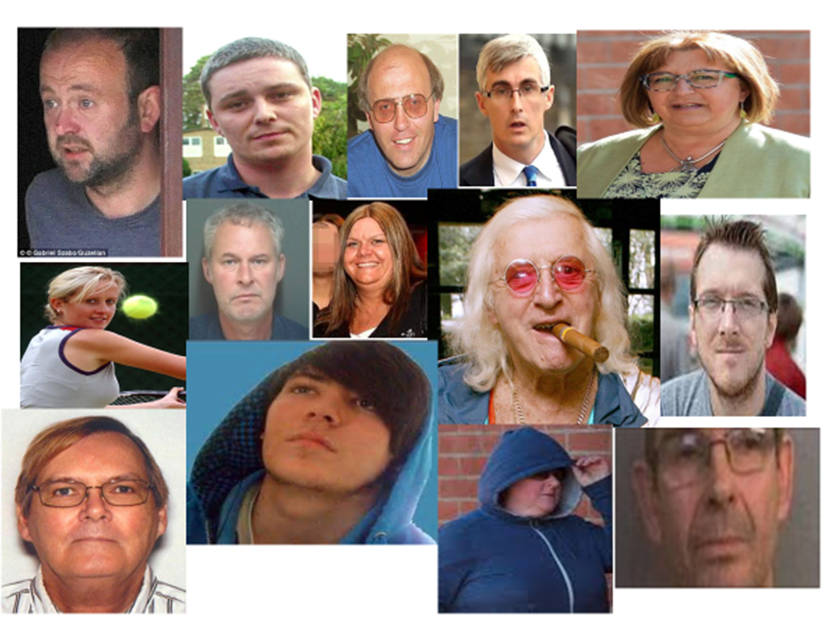
Don’t assume it can't happen in your organisation
‘
Don’t think “What if I’m wrong?”
think “What if I’m right?”
Notes:
Rosie
Please take a moment to study these images.
On the screen you will see a number of faces, // some of which you will recognise.
You will see from these images that they are all different ages and gender. What you won’t know is that in addition to this they all have different beliefs, ethnic and cultural backgrounds.
Some are paid employees while others are volunteers.
What is common among all these people is that they were all working with children and young people and gone on to harm them while in their role.
CLICK
For you as the DSL, your challenge // along with your senior leadership team // is to have your staff thinking // not what if I am wrong // but thinking – when they observe inappropriate behaviour from a colleague, what if I am right?
In every case the abuse perpetrated by these individuals resulted in public enquires and serious case reviews (practice learning reviews). There has been operation Yew tree in relation to Jimmy Saville, there was the Soham public enquiry with regards to Ian Huntley, Barry Bennell a former football coach and scout formally with Crew Alexander, Manchester City and Stoke City who was convicted of more than 50 sexual offences against 22 boys. In all these cases there were common failures by organisations which I will now explore in the next slide.

Slide 18
What have we learnt
Dismissive
Disbelief
Children and Young people not being heard
Professional curiosity/challenge
Cumulative harm and risk
Notes:
Rosie
Some of the learning may seem obvious,
CLICK
// however it is really important that as professionals we are mindful of how we communicate with children so we don’t overlook the small or seemingly trivial details as they may be significant.
CLICK
It is important that you never dismiss what you are being told without first carefully considering and understanding the concerns that are being shared with you.
CLICK
It is important in the busyness of the day that professionals and practitioners make the time and provide the opportunity for young people to talk about their feelings and experiences.
CLICK
And this means always being professionally curious about what they are telling you, and unpicking what it is a young person is saying. They may use words or terms that feel uncomfortable but we need to look beyond this to understand what they are trying to communicate and the context of their concerns.
We know from research that often inappropriate behaviour from professionals can be so low level that they may go unreported and unrecorded and not meet any threshold for action. Yet when these low level concerns are looked at over time they may indicate a pattern of abusive behaviour.
Lets now look at the features of organisations which have robust safeguarding expectation's and arrangements

Slide 19
Features of a safer culture
Open, no secrets
Belief that ‘it could happen here’
Clear procedures for reporting concerns i.e. whistleblowing / confidential report policy.
Support in raising concerns and commitment to take action
Setting acceptable standards of behaviour
Policies and procedures put into practice
Induction and probationary periods
Commitment to safeguarding and an ongoing culture of vigilance
Notes:
Karen
It is really important that you and your senior leadership team create a working culture of transparency, integrity and honesty. There should never be barriers to sharing concerns.
Opportunities such as staff meetings, training and supervision to get across to your colleagues that there may be someone working for the organisation motivated to harm children and young people. They need to understand that young people don’t get harmed in ‘other’ organisation but that this could happen within ‘your’ organisation.
A transparent working culture needs to have a whistleblowing policy and clear procedures for reporting concerns. This would include reassuring all staff that concerns will be treated seriously, proportionately and in confidence. The person raising the concerns should be reassured that they have done the right thing in coming forward and provided with any support they may need.
A strong safeguarding culture can only come about through senior leadership teams providing the rest of the staff group with positive and professional role modelling behaviours. The expectations of how you behave towards young people should be explicitly clear to all staff within your organisation.
The importance of a comprehensive and well monitored induction and probation process is critical to ensuring that new employees have safe values and beliefs that align with your organisations ethos.
An important part of a safe organisation is to have your staff thinking not what if I am wrong, but thinking – when they observe inappropriate behaviour from a colleague, what if I am right? So, all staff have to be vigilant and act on any inappropriate behaviour they observe.

Slide 20
Involving the LADO service
Notification to the LADO SHOULD be made within ONE working day (‘Working Together…’ 2023)
Report concerns to the Local Authority where the individual works if you feel the LADO criteria has been met
If you are concerned about a member of staff and children are at risk of harm, do not wait to speak with a LADO before taking appropriate safeguarding actions.
Familiarise yourself with how to make a notification to the LADO service in the area where you work
Notes:
Rosie
It is important that you and your senior leadership team create a working culture of transparency, integrity and honesty. There should never be barriers to sharing concerns.
Opportunities such as staff meetings, training and supervision to get across to your colleagues that there may be someone working for the organisation motivated to harm children and young people. They need to understand that young people don’t get harmed in ‘other’ organisation but that this could happen within ‘your’ organisation.
A transparent working culture needs to have a whistleblowing policy and clear procedures for reporting concerns. This would include reassuring all staff that concerns will be treated seriously, proportionately and in confidence. The person raising the concerns should be reassured that they have done the right thing in coming forward and provided with any support they may need.
A strong safeguarding culture can only come about through senior leadership teams providing the rest of the staff group with positive and professional role modelling behaviours. The expectations of how you behave towards young people should be explicitly clear to all staff within your organisation.
The importance of a comprehensive and well monitored induction and probation process is critical to ensuring that new employees have safe values and beliefs that align with your organisations ethos.
An important part of a safe organisation is to have your staff thinking not what if I am wrong, but thinking – when they observe inappropriate behaviour from a colleague, what if I am right? So, all staff have to be vigilant and act on any inappropriate behaviour they observe.

Slide 21
Questions
Notes:
Low concerns policies
Recording and Reviewing
In house Screening tools

