Slide 1
South East Regional Care Cooperative
Introductory slides

Slide 2

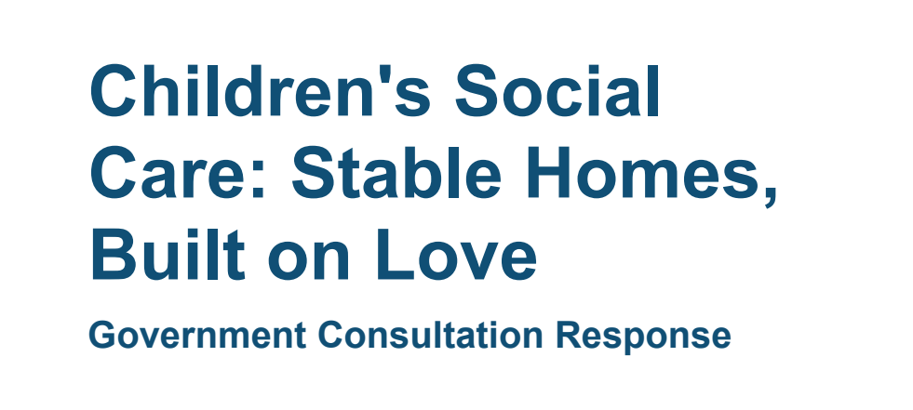

Background
In 2024, the DfE awarded capital and revenue funding to the South East and Greater Manchester to develop Regional Care Cooperatives.
The concept of regionalising activities in children's social care originated in the 2016 Narey review and has been woven through subsequent white papers including the Independent Care Review (2022) and Stable Homes, Built on Love (2023).
The Children's Wellbeing and Schools bill (currently going through the House of Commons) will allow government to mandate regional cooperation.
Today, the South East RCC has an ambitious plan to improve the status quo for the region's children. The RCC will be established by December 2025.

Slide 3
What problems do we exist to solve?
A system which is not designed for children with multiple complex needs
Lack of an agreggated data set to understand the profile of looked-after children regionally
No common way of working between neighbouring Local Authorities, health and youth justice
Increasing cost of residential placements
Challenges in recruitment and retention of care staff
The bottom line...
Spend on Children's Social Care could rise by as much as 25% in the next five years, placing many Local Authorities at risk of bankruptcy.
Simultaneously, outcomes for children are inconsistent and fragmented.
We must work together to break the cycle of rising costs and worsening outcomes.

Slide 4





Our strategic priorities
1
2
3
4
5
Centring activity around the voices of care experienced children and young people
Commissioning care placements for children with complex needs
Bringing all stakeholders and partners in the region together​​
Developing the local workforce
Creating a sustainable RCC that meets the needs of the South East

Slide 5




Successes to date (1)
South central framework
We will incorporate this framework into the RCC and develop it based on regional data and provider engagement.
Provider engagement
We are driving ongoing engagement with providers in the region on framework development and market challenges. From June, we will host quarterly regioanl market engagement events.
Health involvement
We are engaged with all eight ICBs in the South East to co-design their involvement. This includes working with their commissioners and seeking input from those with lived experience of DOLOs and tier 4.
New provision
Capital awarded as part of the RCC pathfinder will fund 40+ new beds across the region.

Slide 6



Successes to date (2)
BERRI pilot programme
We are working with four LAs to pilot BERRI, which aims to step children down (in a sustainable way) from residential to foster care through tracking their needs over time. Training will be completed by end of March and the pilot will run until the end of the year.
Commissioning working group
We are facilitating monthly meetings to share best practice and updates. A series of training workshops will begin at the end of March around integrated commissioning, the new procurement act and workign with planning.
Complex needs capital bids
We supported LAs to submit these bids, providing templates, QA and site visits to support home design.

Slide 7



Successes to date (3)
Data platform
We are building a data platform to aggregate data from all LAs in the region. Data sharing agreements have been signed and a regional sufficiency statement will be developed by July.
Youth participation
We are incubating the South East Youth Participation Collective (SEYPC) to bring participation workers and young people throughout the region together.
Workforce development
We are partnering with the Staff College to create a workforce development programme, incorporating a workforce academy, career pathways, leadership development training and mentoring/buddying.

Slide 8
How will we work?
Our vision and values demonstrate the type of organisation we are: unafraid to challenge the status quo and relentlessly pursuing a better future for children and young people in the South East
"By working together across the South East, we will provide the right care for you that is available locally and when needed. We will be loving, caring and consistent with high aspirations for you.
We will listen to you, put your needs first and will not give up on you. By working together, your voice will be stronger and more influential."
Vision
Focus on outcomes for children and young people
Co-create with children and young people
Willing to explore the unknown and face risks together
Commitment from members and partners
Stronger together
Collaborate transparently
Values
Be disruptive in the market
Work in the interests of the region
We believe we can be more impactful by working at arms length from South East local authorities. To achieve this, the RCC will be established as a Public Service Mutual, accountable to a board of stakeholders from across the region and sector.
Structure

Slide 9
What does success look like?
Everything we do is driven by two objectives, which we believe go hand in hand:
Accessible and actionable data for all LAs
Tailored provision which aligns with the needs of individual young people
Children cared for locally
Better outcomes for young people in care
Improved value for money for Local Authorities
Stronger relationships built with providers
A stable and skilled workforce
Placements commissioned regionally for children with complex needs

Slide 10
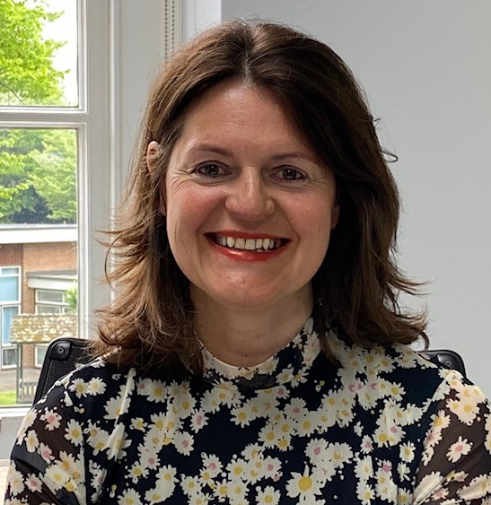
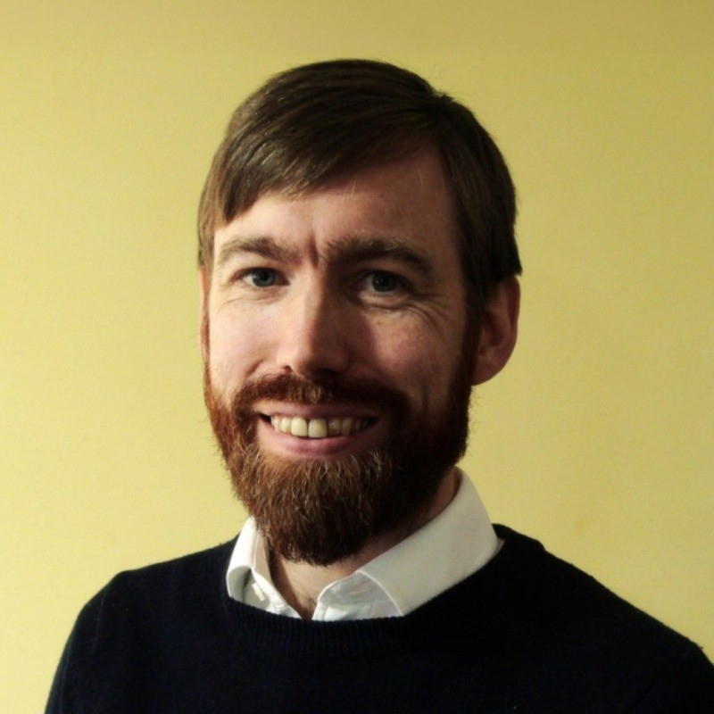
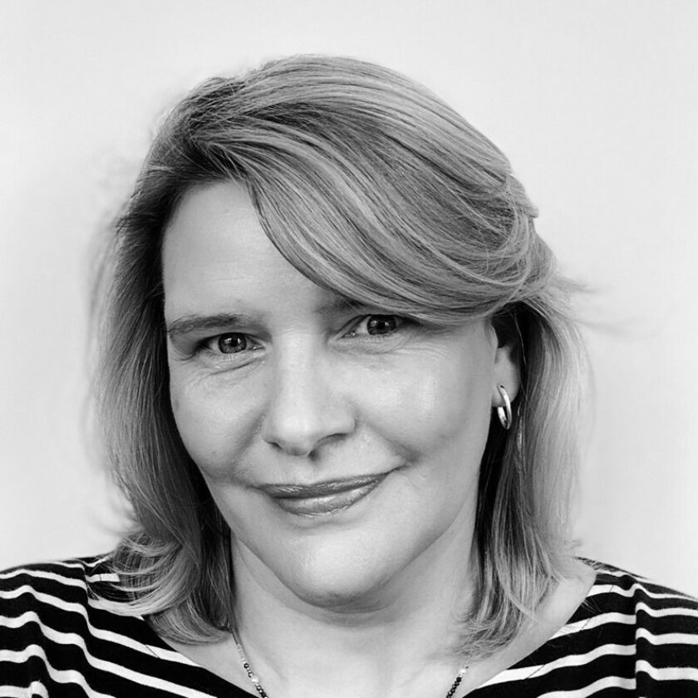
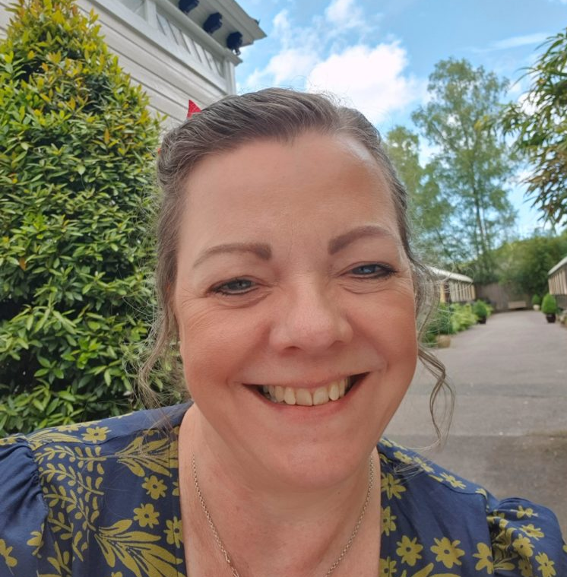
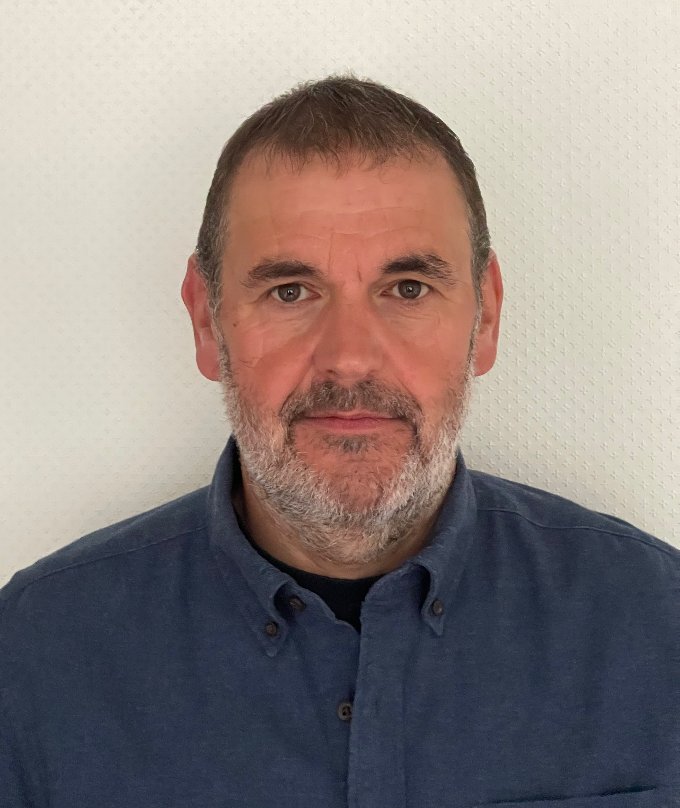
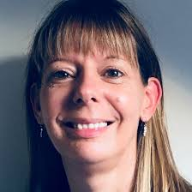
Let's connect!
Please get in touch if you'd like more information, and to work with us.
We welcome engagement from partners, providers and others working in children's social care in the South East.
Lucy Butler
Director
Lucy.butler@westsussex.gov.uk
Alistair Herbert
Data lead
Alistair.herbert@eastsussex.gov.uk
Wendy Williams
Commissioning lead
Wendy.williams2@outlook.com
Helen Humphry
Business manager
Helen.humphry@westsussex.gov.uk
Mark Evans
Project lead
Mark@markevansconsulting.co.uk
Nancy Sayer
Health partnership lead
Nancy.sayer@nhs.net

