Slide 1
Reflecting upon, and evidencing the education standard
Registered Managers Forum
June 10th 2024

Slide 2
Welcome to the session-
following through the theme today- we will look at the education standard and reflect upon the evidence you can gather / offer.

Slide 3
What does the standard say ?
The education standard
8.—(1) The education standard is that children make measurable progress towards achieving their educational potential and are helped to do so.
(2) In particular, the standard in paragraph (1) requires the registered person to ensure—
(a)that staff—
(i)help each child to achieve the child’s education and training targets, as recorded in the child’s relevant plans;
(ii)support each child’s learning and development, including helping the child to develop independent study skills and, where appropriate, helping the child to complete independent study;
(iii)understand the barriers to learning that each child may face and take appropriate action to help the child to overcome any such barriers;
(iv)help each child to understand the importance and value of education, learning, training and employment;
(v)promote opportunities for each child to learn informally;

Slide 4
(vi)maintain regular contact with each child’s education and training provider, including engaging with the provider and the placing authority to support the child’s education and training and to maximise the child’s achievement;
(vii)raise any need for further assessment or specialist provision in relation to a child with the child’s education or training provider and the child’s placing authority;
(viii)help a child who is excluded from school, or who is of compulsory school age but not attending school, to access educational and training support throughout the period of exclusion or non-attendance and to return to school as soon as possible;
(ix)help each child who is above compulsory school age to participate in further education, training or employment and to prepare for future care, education or employment;
(x)help each child to attend education or training in accordance with the expectations in the child’s relevant plans; and
(b)that each child has access to appropriate equipment, facilities and resources to support the child’s learning

Slide 5
What does it mean ?
This divides into two parts essentially:
What do others have to do
What you have to do .
Discussion- any thoughts on this ?

Slide 6
Reality check…..
Ofsted 2021:- In our sample of 2,600 children living in children’s homes:
2,165 children (83%) attended educational provision eligible for Ofsted inspection
9% attended unregulated provisions
6% were not in education, employment or training
2% attended educational provision inspected by the Independent Schools Inspectorate (ISI)

Slide 7
Reality check…..
Of the 2,165 children in our sample who attended an educational provision eligible for Ofsted inspection, - - 57% were in special schools (35% independent special schools and 22% in state-funded special schools).
the remaining 43% of children attended mainstream education (6% independent mainstream education and 37% state-funded mainstream education
The numbers of young people needed SEND provision is stark…this is an area of LA provision which is under the most tension…..

Slide 8
Reality check…..
When looking beyond our sample to all children living in children’s homes and attending state-funded education nationally (approximately 2,500 children), 47% had EHC plans. A further 27% were receiving SEN support. For all children nationally, the proportions were 3% and 12% respectively.
What is the implication for a children’s home in terms of staff training and development in order to meet the standard?

Slide 9
Reality check…..
Although less than 1% of all state-funded, mainstream-educated children attended PRUs nationally, the figure was 18% in our sample. Children in children’s homes make up less than 0.1% of the state-funded school population, but they represent more than 3% of the PRU population.

Slide 10
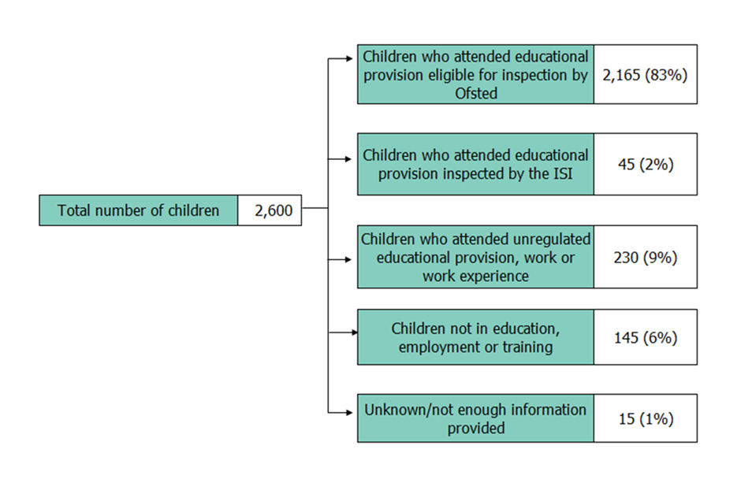
Numbers and representation

Slide 11
Issues arising
What are the challenges and potential barriers in your own services and with other agencies / professionals?
Discuss at your tables and then we will review

Slide 12
Proving it….
It is useful to map the standard to see what evidence you have and where your gaps are.
In some cases, regulators find that the basics have been missed.
Some examples to follow ….

Slide 13
Evidence ?
Local authorities
Local authorities have a duty under section 22(3A) of the Children Act 1989 to promote the educational achievement of their looked-after children, which includes, as set out in guidance, seeking a school or other education setting that is best suited to the child’s needs. The local authorities’ responsibilities as corporate parent apply wherever the child is placed.
Is this clear ? In place at time of placement? If not , why not ?

Slide 14
Evidence ?
Local authorities
Promoting the Education of Looked-After Children describes how local authorities are expected to comply with their duties to promote the education of looked-after children:
When commissioning a placement in a children's home the placing authority must establish how the home will support the child's educational needs. In accordance with regulation 5 (engaging with the wider system to ensure children's needs are met), homes must have proactive relationships with appropriate schools and educational support services. The home should have processes that enable staff to share their experience and understanding of the child’s educational needs and progress with other services.
Is this in place ? Have you got a copy of the guidance to refer to and use in order to challenge ?
Notes:
https://assets.publishing.service.gov.uk/government/uploads/system/uploads/attachment_data/file/683556/Promoting_the_education_of_looked-after_children_and_previously_looked-after_children.pdf

Slide 15
Your responsibility….
Staff need to have the knowledge and skills to understand each child's education and training targets and their next steps for learning. Do they? Anything on your workforce development plan ?t
If a child's progress is not in line with their agreed targets or next steps, staff should seek expert advice from education professionals, such as the Virtual School Head, SENCO, learning mentor or teacher. Staff must challenge the child’s education or training provider if the child does not receive sufficient support to progress as outlined in their relevant plans. Looking for professional challenge not alienation …..
Children's home staff should act as effective advocates for or on behalf of a child who may be experiencing difficulties with education or training matters including, but not limited to, attainment, admissions, attendance or behaviour, as a good parent would do.

Slide 16
Virtual heads:
If a looked-after child from a different local authority area is placed in the home, the Virtual School Head of that local authority remains responsible for promoting the child's educational achievement.
If the homes’ host authority are responsible, then their VH retains responsibility ?
Evidence of contact , negotiation ,feedback…..?

Slide 17
Where is the child in this?
Evidence – the voice of the child heard ?
Formally
Informally?
Directly involved in decision making about their education and care ?
Advocacy-who does this ? How do they do it ? Training ? Is it subjective or objective? Does it hold assumption / bias ? Is it well informed ? Is it about the child and nothing else?

Slide 18
What about being out of education ?
The registered person must ensure the necessary support is given to children to enable them to access their education or training. Support may include, for example, putting in place practical arrangements such as transporting the child to school, support by staff to learn how to use public transport confidently and safely, or the use of technology to connect with online learning.
Children should be in full-time education whilst they are of compulsory school age, unless their personal education plan contained within the care plan or other relevant plan states otherwise. The home must aim to support full time attendance at school unless the child’s relevant plan indicates this is not in their best interests.
If the young person is not in full time education have a complete evidence trail to hand of all aspects of your involvement , advocacy . Escalate to the VH. Be the pushy parent!

Slide 19
What about being out of education ?
Where children placed in a home are not participating in education because they have been excluded or are not on a school roll for some other reason, the registered person and staff must work closely with the placing authority so that the child is supported and enabled to resume full-time education as soon as possible.
In the interim, the child should be supported to sustain or regain their confidence in education and be engaged in suitable structured activities. How? Do you have sufficient information from the school ? Are the staff trained / skilled in the structured activities?
If no education place is identified by the placing authority, the registered person must challenge them to meet the child’s needs under regulation 5 (engaging with the wider system to ensure children’s needs are met
Do you have evidence of this level of challenge ?

Slide 20
Education at home ….
The ethos of the home should support each child to learn, emphasising the value of independent study and reading for enjoyment.
The home must make available suitable facilities, equipment and resources for learning and ensure that the home's routines do not form barriers to children wishing to use the homes resources to study. Staff must support children with home study by encouraging them to learn independent study skills and helping them to practice those skills.
Children should have access to a computer and the internet to support their education and learning, unless there are specific safeguarding reasons why this would be inappropriate. In such cases, the home should consider whether and how it can support the child to access a computer and the internet safely.Can you do this ?

Slide 21
Timetables…..
a new minimum expectation on the length of the school week of 32.5 hours for all mainstream, state-funded schools Guidance July 2023 as below:
https://assets.publishing.service.gov.uk/media/64a2f21fbb13dc000cb2e5e1/Minimum_School_Week_Non-Statutory_Guidance.pdf
The expectation does not apply to pupils in:
early years (including in school settings) due to the age of pupils
16-19 education (including school sixth forms) due to the variation in their courses and having different guided learning hours
specialist settings (special schools and alternative provision), due to the varying needs of their pupil cohorts and the particular operational challenges they may face.

Slide 22
Timetables
Time tables should have clear links to education plans , PEP, EHCP etc. Try to make sure that these are always aligned in your records. Sometimes timetables get adapted and can become out of sync with the other paperwork.

Slide 23
Small groups-
Make a list of what you would consider to be minimum evidence for the education standard?
Feedback and review

Slide 24

Any thoughts or follow up?
Thank you.

